Slide 1
GOD
GOD

Slide 2
if anyone suffers as a Christian, he is not to be ashamed, but is to glorify God in this name.
GOD
GOD
1 Peter 4:16
Notes:
1 Pet. 4:16
if anyone suffers as a Christian, he is not to be ashamed, but is to glorify God in this name.
Suffering AS a Christian (for being one) –
Slander YOU – but it your FAITH that is questioned –
FAITH – the question is the BASIS of your FAITH –
→ We are often accused of a ‘leap of faith’ – believing just to believe without any evidence or basis for such.

Slide 3
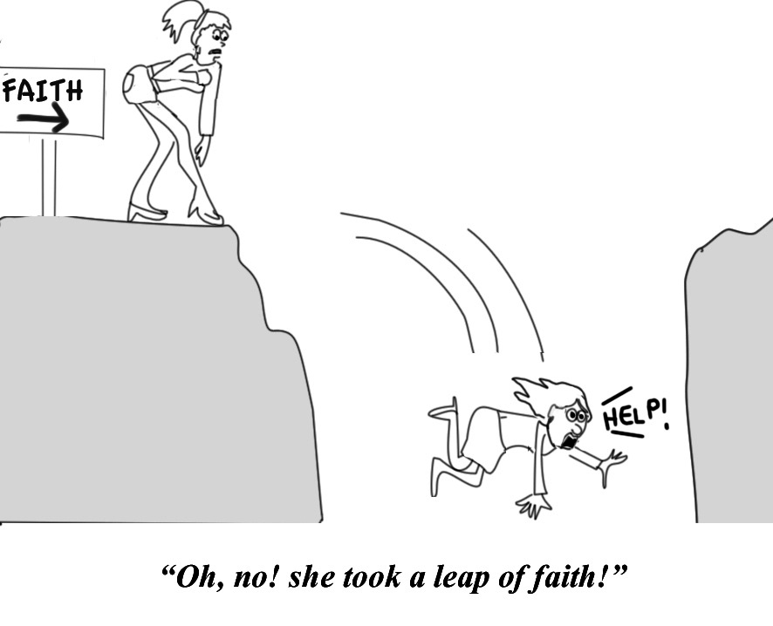
GOD
GOD
Notes:
Leap of faith –
Believing something that there is no reason to believe, no evidence that would convince..
You can't convince a believer of anything; for their belief is not based on evidence, it's based on a deep-seated need to believe. --Carl Sagan
"In Scripture, faith involves placing trust in what you have reason to believe is true. Faith is not a blind, irrational leap into the dark. So faith and reason cooperate on a biblical view of faith. They are not intrinsically hostile."
Author: J.P. Moreland
→ “evidence’ is often found in ‘testimony’ –

Slide 4
Faith based upon testimony
GOD
GOD
Notes:
‘Faith’ is often based upon ‘testimony’ –
Trust because of another’s testimony of what they experience or know.
This is at the heart of much legal decision making! Even in the LAW of Moses…
→ Deut. 19:15 at the mouth of two or three witnesses...

Slide 5
‘At the mouth of two or three witnesses…’
GOD
GOD
Deut. 19:15; Num. 35:30;
2 Cor. 13:1
Notes:
Deut. 19:15 “A single witness shall not rise up against a man on account of any iniquity or any sin which he has committed; on the evidence of two or three witnesses a matter shall be confirmed.
Num. 35:30 ‘If anyone kills a person, the murderer shall be put to death at the evidence of witnesses, but no person shall be put to death on the testimony of one witness.
2 Cor. 13:1 This is the third time I am coming to you. Every fact is to be confirmed by the testimony of two or three witnesses.
→ Back to PETER – his writings contain the TESTIMONY of a witness… 1Pet. 5:1

Slide 6
… a witness of the sufferings of Christ...
GOD
GOD
1 Peter. 5:1
Notes:
1Pet 5.1
Therefore, I exhort the elders among you, as your fellow elder and witness of the sufferings of Christ, and a partaker also of the glory that is to be revealed,
2 shepherd the flock of God among you, exercising oversight not under compulsion, but voluntarily, according to the will of God;
→ 2 Pet. 1:16-18

Slide 7
Eyewitnesses of His majesty
GOD
GOD
2 Peter 1:16-18
Notes:
2 pet. 1:16-18 for we did not follow cleverly devised tales when we made known to you the power and coming of our Lord Jesus Christ, but we were eyewitnesses of his majesty.
17 for when he received honor and glory from god the father, such an utterance as this was made to him by the majestic glory, “this is my beloved son with whom i am well-pleased”—
18 and we ourselves heard this utterance made from heaven when we were with him on the holy mountain.
→ This is thus the basis of the writings of the nt – cp. Luke 1:1-2

Slide 8
…eyewitnesses and ministers of the word have delivered them to us.
GOD
GOD
Luke 1:1-2
Notes:
Luke 1:1-12
Inasmuch as many have undertaken to compile an account of the things accomplished among us,
just as they were handed down to us by those who from the beginning were eyewitnesses and servants of the word,
→ The basis of the commission – whole of preaching of apostles – TESTIMONY … Luke 24:45-49

Slide 9
You are witnesses of these things…
GOD
GOD
Luke 24:45-49
Notes:
Now He said to them, “These are My words which I spoke to you while I was still with you, that all things which are written about Me in the Law of Moses and the Prophets and the Psalms must be fulfilled.”
45 Then He opened their minds to understand the Scriptures,
46 and He said to them, “Thus it is written, that the Christ would suffer and rise again from the dead the third day,
47 and that repentance for forgiveness of sins would be proclaimed in His name to all the nations, beginning from Jerusalem.
48 “You are witnesses of these things.
49 “And behold, I am sending forth the promise of My Father upon you; but you are to stay in the city until you are clothed with power from on high.”
→ THEN, this is followed by the whole death, burial, resurrection, and APPEARANCES…. Acts 1:1-3

Slide 10
Death Burial Resurrection Appeared
GOD
GOD
Acts 1:1-3
Notes:
Acts 1:1-3 The first account I composed, Theophilus, about all that Jesus began to do and teach,
2 until the day when He was taken up to heaven, after He had by the Holy Spirit given orders to the apostles whom He had chosen.
3 To these He also presented Himself alive after His suffering, by many convincing proofs, appearing to them over a period of forty days and speaking of the things concerning the kingdom of God.
→ THEN vs. 8 - you shall be MY witnesses…

Slide 11
You shall be My witnesses…
GOD
GOD
Acts 1:8
Notes:
Acts 1:8 So when they had come together, they were asking Him, saying, “Lord, is it at this time You are restoring the kingdom to Israel?”
7 He said to them, “It is not for you to know times or epochs which the Father has fixed by His own authority;
8 but you will receive power when the Holy Spirit has come upon you; and you shall be My witnesses both in Jerusalem, and in all Judea and Samaria, and even to the remotest part of the earth.”
→ Choosing a replacement apostle based upon this need / qualification of WITNESS…. Acts 1:22

Slide 12
Matthias a witness
GOD
GOD
Acts 1:22 -
Notes:
Acts 1:21-22 “Therefore it is necessary that of the men who have accompanied us all the time that the Lord Jesus went in and out among us—
22 beginning with the baptism of John until the day that He was taken up from us—one of these must become a witness with us of His resurrection.”
→ So began the preaching… Acts 2:32

Slide 13
“.. Of this we all are witnesses.”
GOD
GOD
Acts 2:32
Notes:
Acts 2:32
Sermon – what Jesus did – vs. 22-23
Then - “This Jesus God raised up again, to which we are all witnesses.
Vs. 36 - Let all the house of Israel know assuredly…
→ 2nd sermon like the first... 3:15

Slide 14
“… a fact to which we are witnesses.”
GOD
GOD
Acts 3:15
Notes:
Acts 3:15 But when Peter saw this, he replied to the people, “Men of Israel, why are you amazed at this, or why do you gaze at us, as if by our own power or piety we had made him walk?
13 “The God of Abraham, Isaac and Jacob, the God of our fathers, has glorified His cservant Jesus, the one whom you delivered and disowned in the presence of Pilate, when he had decided to release Him.
14 “But you disowned the Holy and Righteous One and asked for a murderer to be granted to you,
15 but put to death the aPrince of life, the one whom God raised from the dead, a fact to which we are witnesses.
→ When questioned – Acts 4:19-20

Slide 15
“… We cannot but speak of what we have seen and heard.”
GOD
GOD
Acts 4:18-20
Notes:
Acts 4:18-20 - And when they had summoned them, they commanded them not to speak or teach at all in the name of Jesus.
19 But Peter and John answered and said to them, “Whether it is right in the sight of God to give heed to you rather than to God, you be the judge;
20 for we cannot stop speaking about what we have seen and heard.”
→ Acts 5:28-32

Slide 16
“And we are witnesses of these things”
GOD
GOD
Acts 5:28-32
Notes:
Acts 5:28-32 saying, “We gave you strict orders not to continue teaching in this name, and yet, you have filled Jerusalem with your teaching and intend to bring this man’s blood upon us.”
29 But Peter and the apostles answered, “We must obey God rather than men.
30 “The God of our fathers raised up Jesus, whom you had put to death by hanging Him on a cross.
31 “He is the one whom God exalted to His right hand as a bPrince and a Savior, to grant repentance to Israel, and forgiveness of sins.
32 “And we are witnesses of these things; and so is the Holy Spirit, whom God has given to those who obey Him.”
→ Acts 10:39-40

Slide 17
“We are witnesses of all that he did…”
GOD
GOD
Acts 10:38-41
Notes:
Acts 10:38-41 “You know of Jesus of Nazareth, how God anointed Him with the Holy Spirit and with power, cand how He went about doing good and healing all who were oppressed by the devil, for God was with Him.
39 “We are witnesses of all the things He did both in the land of the Jews and in Jerusalem. They also put Him to death by hanging Him on a cross.
40 “God raised Him up on the third day and granted that He become visible,
41 not to all the people, but to witnesses who were chosen beforehand by God, that is, to us who ate and drank with Him after He arose from the dead.
→ BACK to where we began – after preaching the rest of his life, still basis his testimony on witness!

Slide 18
A witness of the sufferings of Christ..
GOD
GOD
1 Peter. 5:1
Notes:
1Pet. 5:1-3 Therefore, I exhort the elders among you, as your fellow elder and witness of the sufferings of Christ, and a partaker also of the glory that is to be revealed,
2 shepherd the flock of God among you, exercising oversight not under compulsion, but voluntarily, according to the will of God; and not for sordid gain, but with eagerness;
3 nor yet as lording it over those allotted to your charge, but proving to be examples to the flock.
→ The nature of THEIR witness …

Slide 19
Eye Witness
GOD
GOD
2 Pet. 1
Notes:
Nature of their witness / testimony - Eye Witness 2 Pet. 1: 13 I consider it right, as long as I am in this earthly dwelling, to stir you up by way of reminder,
14 knowing that the laying aside of my earthly dwelling is imminent, as also our Lord Jesus Christ has made clear to me.
15 And I will also be diligent that at any time after my departure you will be able to call these things to mind.
Eyewitnesses
16 For we did not follow cleverly devised tales when we made known to you the power and coming of our Lord Jesus Christ, but we were eyewitnesses of His majesty.
17 For when He received honor and glory from God the Father, such an autterance as this was made to Him by the Majestic Glory, “This is My beloved Son with whom I am well-pleased”—
18 and we ourselves heard this utterance made from heaven when we were with Him on the holy mountain.
→ NOT a ‘one time event’ -

Slide 20
NOT a ‘one time’ event -
GOD
GOD
Notes:
NOT a ‘one time event’ –
NOT like game of telephone – but lived with Jesus, ate with Jesus, asked questions, observed the miracles, heard him foretell the resurrection…
THEN was with him for 40 days... Saw, heard, ate with...
Their common testimony: of the resurrection

Slide 21
Of ‘the resurrection’ -
GOD
GOD
Notes:
Witnesses of the resurrection
NOT see the EVENT… but Saw Jesus DIE, buried, waited, and THEN the appearances...
Such belief of testimony needs to be evaluated... But such is the nature of LIFE and decisions... Do you believe the testimony?

Slide 22
Faith based upon testimony Do You Believe?
GOD
GOD

Slide 23
GOD
GOD

Slide 24
GOD
GOD

