Slide 2
Zeal is not enough
● Zeal is not enough

Slide 3
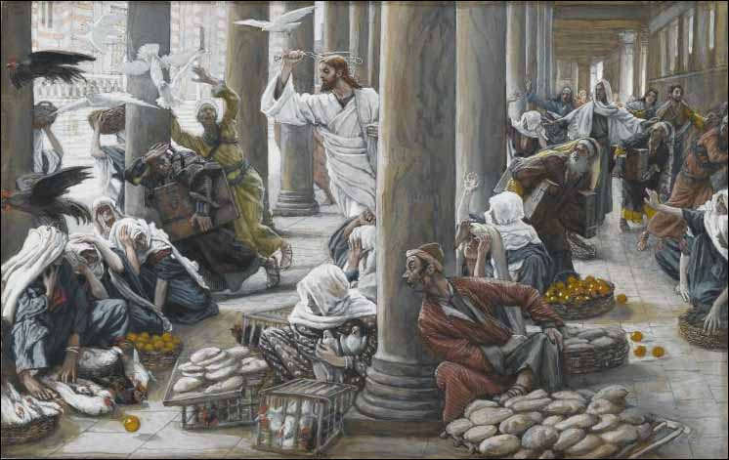

Slide 4
Zeal is not enough
● Zeal is not enough
● Entertainment is not the same as worship

Slide 5
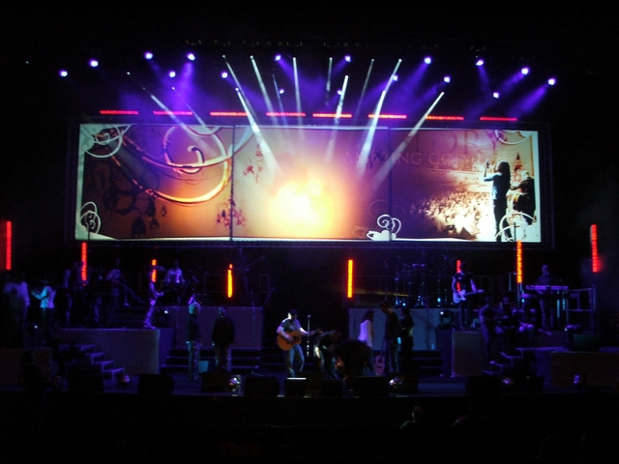
Notes:
Is this a worship service? Or a rock concert? Is the difference important? What is the difference?

Slide 6
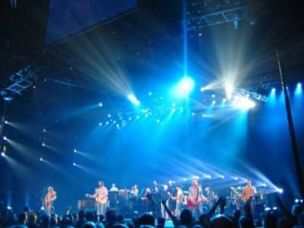
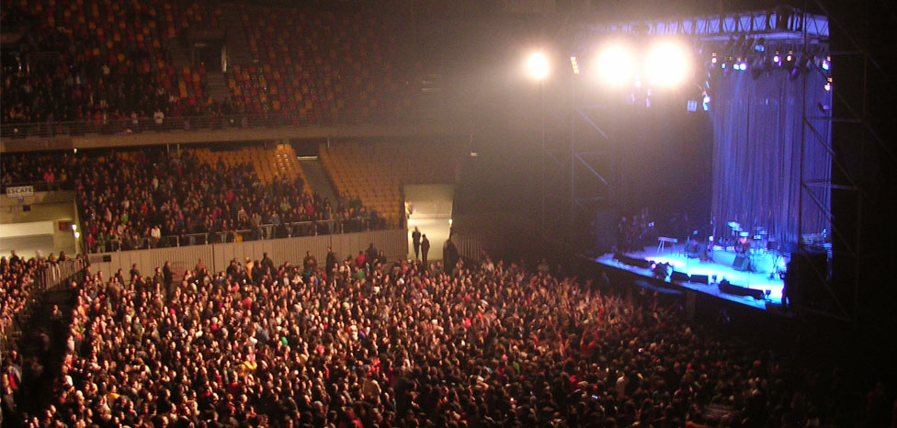
Worship?

Slide 7
Zeal is not enough
● Zeal is not enough
● Entertainment is not the same as worship
- Applause in the worship?

Slide 8
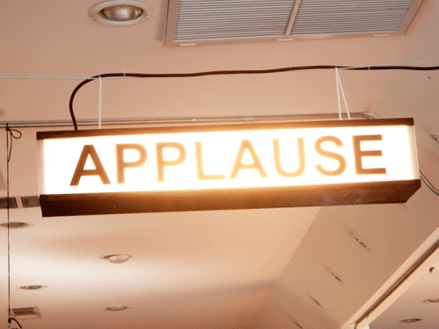

Slide 9
Zeal is not enough
● Zeal is not enough
● Entertainment is not the same as worship
- Applause in the worship?
● Is tradition bad?
● Authority in religion

Slide 10
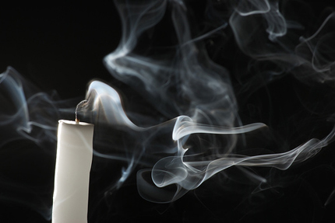

Slide 11
Zeal is not enough
● Zeal is not enough
● Entertainment is not the same as worship
- Applause in the worship?
● Is tradition bad?
● Authority in religion
Will YOU worship God…His way?

Slide 13
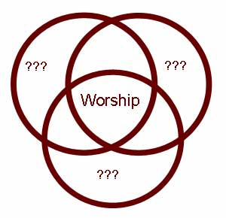

Slide 14
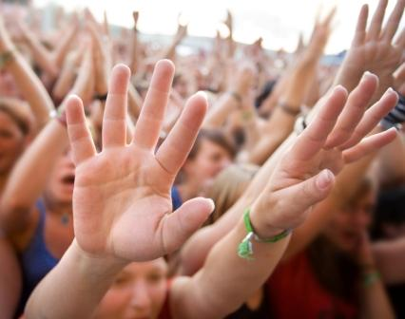

Slide 15
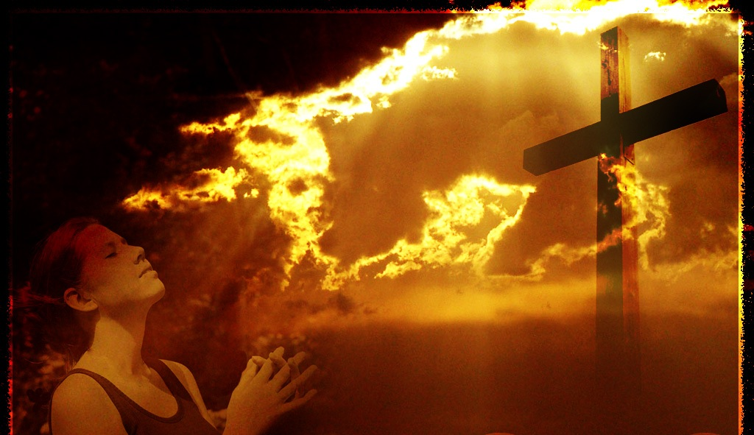

Slide 16
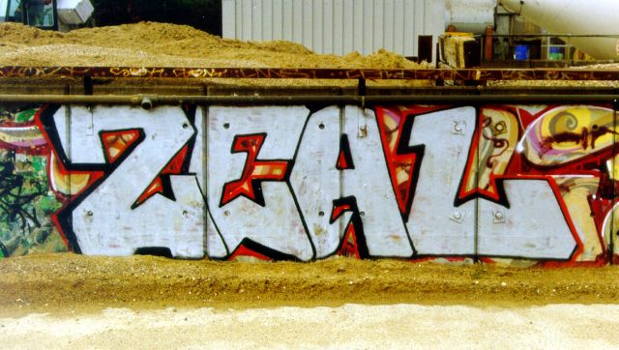

Slide 17
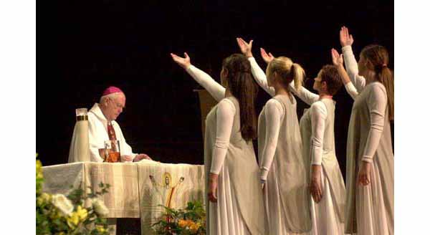

Slide 18
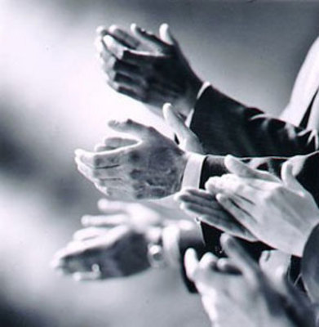

Slide 21
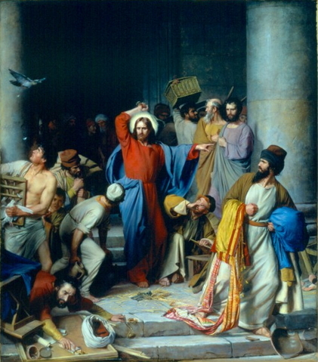

Slide 22
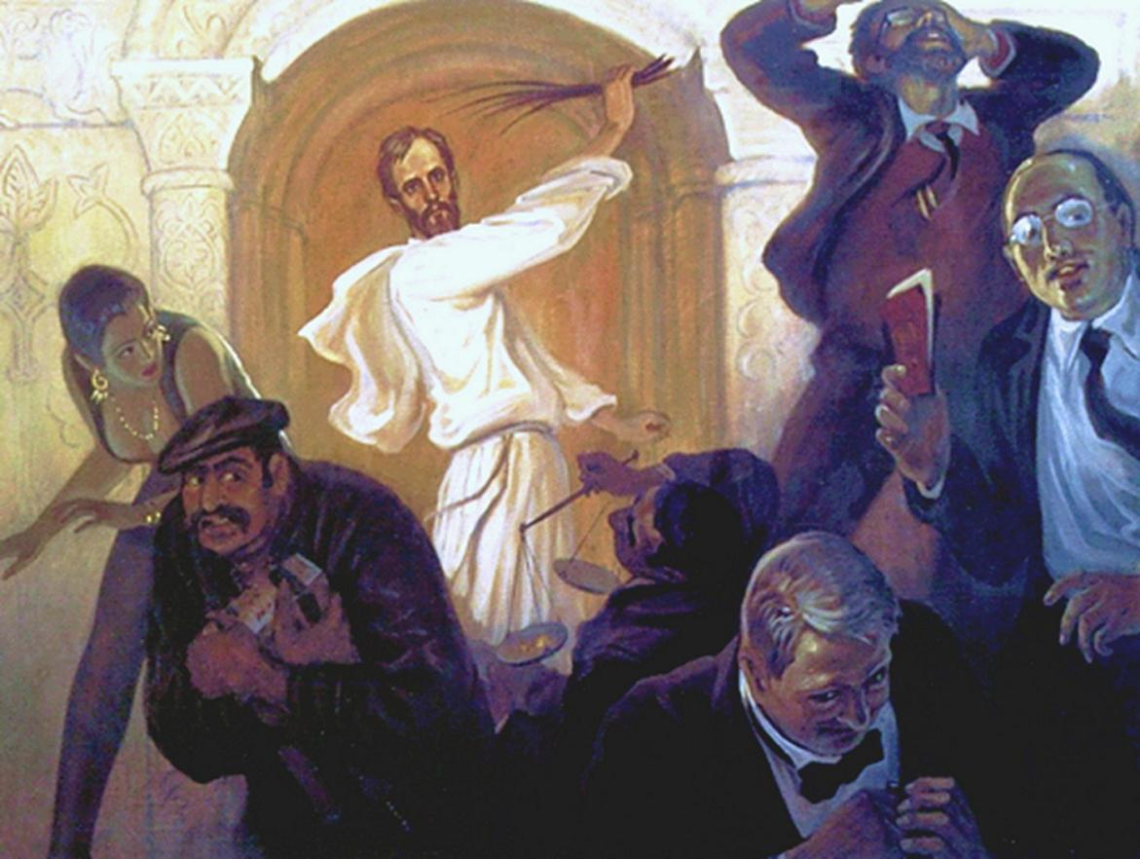

Slide 23
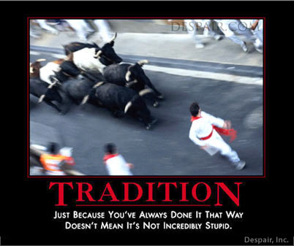

Slide 24
