Slide 1
GOD
GOD

Slide 2
269 - Nothing But The Blood - Title

Slide 3
269 - Nothing But The Blood - 1.1

Slide 4
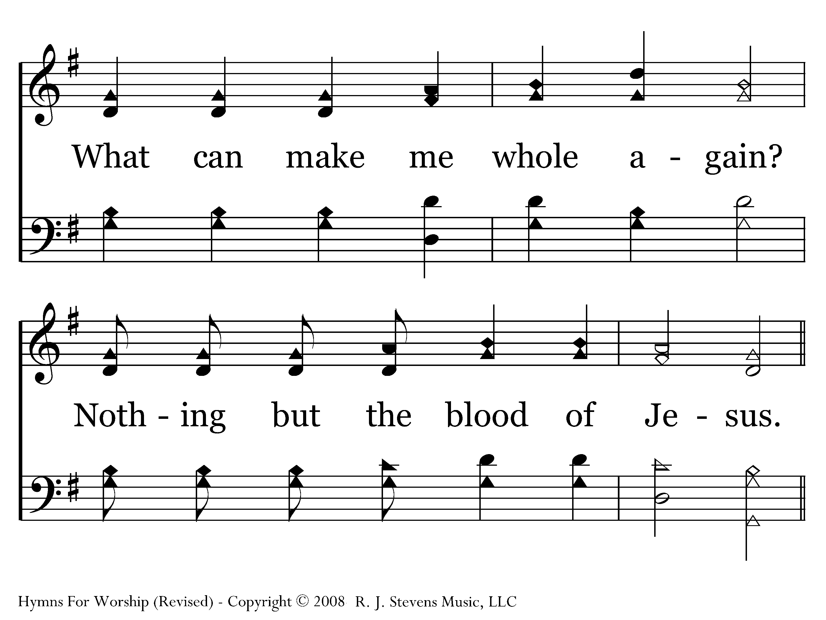
269 - Nothing But The Blood - 1.2

Slide 5
269 - Nothing But The Blood - C.1

Slide 6
269 - Nothing But The Blood - C.2
End of Verse 1

Slide 7
269 - Nothing But The Blood - 2.1

Slide 8
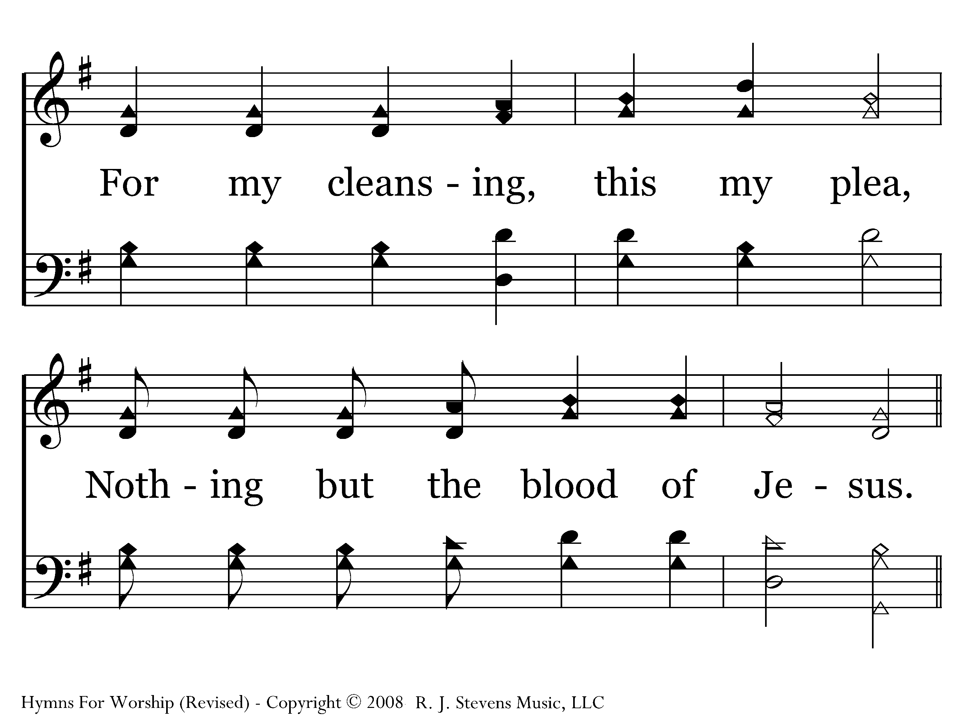
269 - Nothing But The Blood - 2.2

Slide 9
269 - Nothing But The Blood - C.1

Slide 10
269 - Nothing But The Blood - C.2
End of Verse 2

Slide 11
269 - Nothing But The Blood - 3.1

Slide 12
269 - Nothing But The Blood - 3.2

Slide 13
269 - Nothing But The Blood - C.1

Slide 14
269 - Nothing But The Blood - C.2
End of Verse 3

Slide 15
269 - Nothing But The Blood - 4.1

Slide 16
269 - Nothing But The Blood - 4.2

Slide 17
269 - Nothing But The Blood - C.1

Slide 18
269 - Nothing But The Blood - C.2
End of Song

Slide 19
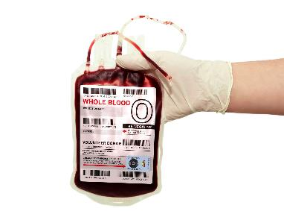
Blood ?
GOD
GOD
Death!
Notes:
Nothing but the BLOOD of Jesus
But, ‘blood’ does NOT refer to the literal ‘blood’ (what came out when pierced )-
BUT TO HIS DEATH…
→ Blood is LIFE

Slide 20
Blood IS LIFE
Life is in the blood –
Deut. 12:23; Lev. 17:11
Shed blood – take the life
Gen. 9:6
Blood of bulls & Goats –
sacrifice of the life
GOD
Notes:
First, ‘blood of Jesus’ is referring to His DEATH, His sacrificial death. The shedding of blood is the taking of the life. Jesus gave HIS LIFE for us.
Life is in the blood –
Deuteronomy 12:23 "Only be sure not to eat the blood, for the blood is the life, and you shall not eat the life with the flesh.
Leviticus 17:11 'For the life of the flesh is in the blood, and I have given it to you on the altar to make atonement for your souls; for it is the blood by reason of the life that makes atonement.'
Shed blood – take the life
Genesis 9:6 "Whoever sheds man's blood, By man his blood shall be shed, For in the image of God He made man.
Blood of bulls and goats – life offered in sacrifice – NOT offer ‘dead sacrifice’, but offer the very life of the animal
→ Jesus is the solution for SIN PROBLEM

Slide 21
Jesus is the solution for SIN
GOD
GOD
Eat → die Gen. 2:17
Sin → die Ezek. 18:20
Wages of sin → death Rom. 6:23
Notes:
Second, the PROBLEM that Jesus is the solution for is SIN and its attendant consequences.
The day you eat, you shall die… Gen. 2:17 separated from God that day…
The Lord God commanded the man, saying, “From any tree of the garden you may eat freely;
17 but from the tree of the knowledge of good and evil you shall not eat, for in the day that you eat from it you will surely die.”
The soul that sins shall DIE – Ezek. 18:20
The wages of sin is death – Rom. 6:23.
→ MY problem = sin

Slide 22
MY Problem: I have sinned
GOD
HELPLESS
Rom. 5:6
GOD
What can I do about it?
Notes:
The problem is not just that ‘all have sinned’, the problem is that I HAVE SINNED.
What CAN I DO ABOUT IT? ‘Naught of good that I have done’ can UNDO it, cannot remedy it, cannot fix it! Vs. 3 –
No ‘act above the call of duty’, when do ‘what is right – doing what we should’, no ‘extra credit works’ – nothing that can undo, redo…
Romans 5:6 For while we were still helpless, at the right time Christ died for the ungodly.
→ Rom. 5 and the death of Jesus

Slide 23
Death of Jesus
GOD
Christ Died – 6
Christ died for us – 8
Through the death of His son - 10
Justified
Saved
Reconciled
GOD
Notes:
Hence the DEATH of Jesus!
Through his death Rom. 5 - (Christ died vs. 6, Christ died for us vs. 8; through the death of His son vs. 10) –
RESULT:
Justified by His blood, saved from wrath of God, reconciled (8-10)
→ Other statements about the ‘blood of Jesus’

Slide 24
Blood of Jesus
GOD
Cleanses from sin – 1Jn. 1:8-9
Robes washed – Rev. 7:14; 22:14
Bodies washed / heart sprinkled – Heb. 10:22 / 1Pet. 1:22
Washed in water – Eph. 5:26
Washing of regeneration Titus 3:5
GOD
Notes:
His blood cleanses from all sin (1John 1:8-9) –
‘robes’ washed in His blood (Rev. 7:14, 22:14) –
washed in water (Eph. 5:26),
bodies washed/hearts sprinkled (Heb. 10:22),
hence were sinners but were ‘washed, justified, … (1Cor. 6:9).
Such is the ‘washing of regeneration’ that brings salvation (Titus 3:5).
→ Sin is an ACT

Slide 25
Problem: Sin is an ACT!
GOD
GOD
Notes:
The problem is that sin is not an ‘object’ but an act! [even ‘lusting’ is the ‘act’ of lusting]
How does one ‘wash’ and ‘act’? Can such acts of sin be literally washed? Can they be literally washed in the ‘blood of Jesus’? I am confident that this is a figure of speech, a word picture.
→ SINS not LITERALLY washed away – either blood OR water

Slide 26
Sins NOT literally washed in EITHER blood or water
Notes:
NOT ‘literally washed’ either in blood or water.
As Cecil Willis wrote: Some very scornfully and ridiculously refer to the commandment of the Lord, and say that we believe that the water literally washes away sins. No, I do not believe the water literally washes away sins, nor do I believe that the blood literally washes away sins, but I do believe that the Lord Jesus Christ forgives us our sins, when we have completed obeying the commandments of the gospel, and not before. http://www.truthmagazine.com/archives/volume20/GOT020268.html).
→ Such language indicates ‘forgive, pardon remit’

Slide 27
Wash / Cleanse
Forgive – pardon - remit
Notes:
What does it PICTURE? The forgiveness, the pardon, the remitting of our sins. All of that takes place in the mind of God. It is God that forgives. It is God that pardons. It thus is God that ‘cleanses’ us from sin, and that is done on the basis of the death of Jesus.
In being baptized we have similar wording and a similar problem. It has often been argued that baptism cannot wash away sin, and literally that is so. It is just as true as saying that the literal blood of Jesus cannot literally wash away sin. Sin is and ACT, and act of rebellion and unlawfulness. Such can be forgiven, pardoned, and atoned for by the death of Jesus, but
Does that then invalidate the PICTURE? Can we then say that the blood of Christ is not needed? Can we say that baptism is not needed? Some do, at least concerning baptism, but is it a valid argument?
→ It is the DEATH of Jesus (blood) that makes it all possible – but baptized into His death

Slide 28
It is the death of Jesus that makes all of this possible, and we are ‘baptized into His death’ (Rom. 6:3-4).
Notes:
It is the death of Jesus that makes all of this possible, and we are ‘baptized into His death’ (Rom. 6:3-4).
→ It is GOD that pardons, forgives, makes alive – when baptized

Slide 29
It is God that forgives and makes us alive, but God works when we are baptized
(Col. 2:12-13).
Notes:
It is God that forgives and makes us alive, but God works when we are baptized (Col. 2:12-13).
¹² Having been buried with Him in baptism, you were also raised with Him through faith in the working of God, who raised Him from the dead. ¹³ And when you were dead in trespasses and in the uncircumcision of your flesh, He made you alive with Him and forgave us all our trespasses.
→ Saved by ‘washing of regeneration’ Titus 3:5

Slide 30
Saved by the ‘washing of regeneration’
Titus 3:5
Notes:
Thus ‘the washing of regeneration’ – Titus 3:5, wherein God Saves…
Thus the Lord “He saved us— not by works of righteousness that we had done, but according to His mercy, through the washing of regeneration and renewal by the Holy Spirit” (Titus 3:5). You can be saved by the blood… for GOD can save you “
→ Arise and be baptized – wash away your sins… Acts 22:16

Slide 31
'Now why do you delay? Get up and be baptized, and wash away your sins, calling on His name.‘
Acts 22:16
Notes:
Acts 22:16 'Now why do you delay? Get up and be baptized, and wash away your sins, calling on His name.'

