Slide 1
Once upon a time
Long, Long ago
In a land Far far away
Lived a …..
GOD
GOD
Notes:
Stories and OUR LIVES
Once upon a time
Long, Long ago
In a land Far far away
Lived a …..
→ Princes Bride

Slide 2
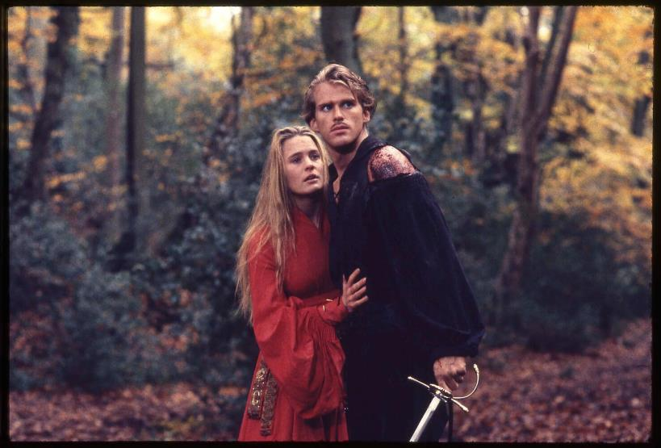
GOD
GOD
Princes Bride
Notes:
Princes Bride
→ Harry Potter

Slide 3
GOD
GOD
Notes:
Harry Potter
→ Star Wars

Slide 4
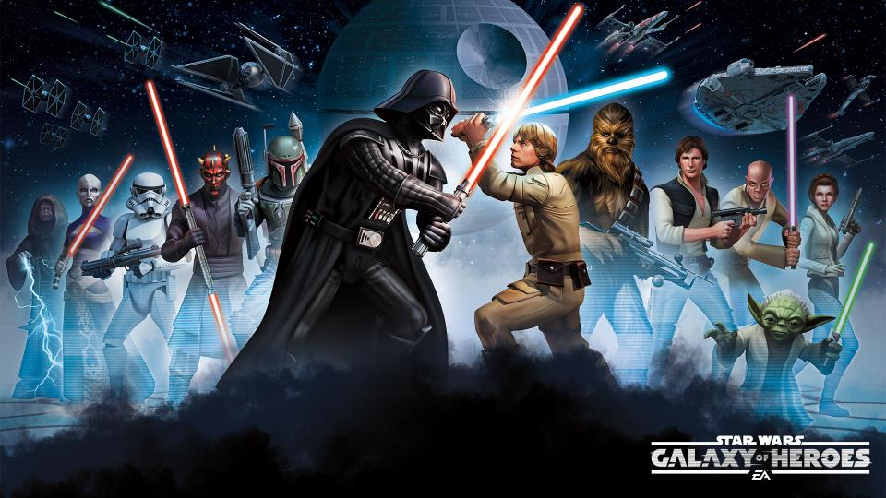
GOD
GOD
Notes:
Star Wars
→ Stories impact our lives

Slide 5
Stories and our Lives?
GOD
GOD
Notes:
The Stories Of Our Lives
Princes Bride, Monty Python’s ‘world’, Harry Potter, Star Wars.
People are highly influenced by the stories of their lives.
In ancient times, the ‘story tellers’ – the ‘historians’ of the people. Memorized thousands of ‘lines’ of such. Repeated them often.
In ancient Israel, such was the very foundation of their nation and heritage.
→ Bible Doesn’t Stand A Chance

Slide 6
… the Bible doesn’t stand a chance. Of course, Aesop’s fables have been a main stay over many centuries and nations. Christians have the ‘reading of the apostle’s memoirs’.
GOD
GOD
Notes:
What are the stories of TODAY? One writer recently wrote, the Bible doesn’t stand a chance. Of course, Aesop’s fables have been a main stay over many centuries and nations. Christians have the ‘reading of the apostle’s memoirs’.
Age of visualization, movies, computer generated fantastic scenes. Start our children off with iPads to do the babysitting, tv to provide entertainment.
As such stories fill the hearts and minds, what principles are they instilling?
Use of Stories to tell the history of God’s people – heritage, values, hopes,…
→ Abraham – Gen. 18:19

Slide 7
"For I have chosen him, so that he may command his children and his household after him to keep the way of the Lord by doing righteousness and justice, so that the Lord may bring upon Abraham what He has spoken about him.“ Gen. 18:19
GOD
GOD
Notes:
Abraham – Genesis 18:19 "For I have chosen him, so that he may command his children and his household after him to keep the way of the Lord by doing righteousness and justice, so that the Lord may bring upon Abraham what He has spoken about him."
→ Moses and the 1st generation

Slide 8
²⁶ "And when your children say to you, 'What does this rite mean to you?' ²⁷ you shall say, 'It is a Passover sacrifice to the Lord who passed over the houses of the sons of Israel in Egypt when He smote the Egyptians, but spared our homes.'" And the people bowed low and worshiped. Ex. 12:26-27
GOD
GOD
Notes:
Moses to first generation:
Exodus 12:26-27 ²⁶ "And when your children say to you, 'What does this rite mean to you?' ²⁷ you shall say, 'It is a Passover sacrifice to the Lord who passed over the houses of the sons of Israel in Egypt when He smote the Egyptians, but spared our homes.'" And the people bowed low and worshiped.
\Again – Ex. 13:14-15

Slide 9
^{Exod. 13:14-15} ¹⁴ "And it shall be when your son asks you in time to come, saying, 'What is this?' then you shall say to him…
GOD
GOD
Notes:
Exodus 13:14-15 ¹⁴ "And it shall be when your son asks you in time to come, saying, 'What is this?' then you shall say to him,
→vs. 15 'With a powerful hand the Lord brought us out of Egypt, from the house of slavery. ¹⁵ 'It came about, when Pharaoh was stubborn about letting us go, that the Lord killed every firstborn in the land of Egypt, both the firstborn of man and the firstborn of beast. Therefore, I sacrifice to the Lord the males, the first offspring of every womb, but every firstborn of my sons I redeem.'

Slide 10
'With a powerful hand the Lord brought us out of Egypt, from the house of slavery. ¹⁵ 'It came about, when Pharaoh was stubborn about letting us go, that the Lord killed every firstborn in the land of Egypt, both the firstborn of man and the firstborn of beast. Therefore, I sacrifice to the Lord the males, the first offspring of every womb, but every firstborn of my sons I redeem.'
GOD
GOD
Notes:
Exodus 13:14-15 ¹⁴ "And it shall be when your son asks you in time to come, saying, 'What is this?' then you shall say to him,
→ 'With a powerful hand the Lord brought us out of Egypt, from the house of slavery. ¹⁵ 'It came about, when Pharaoh was stubborn about letting us go, that the Lord killed every firstborn in the land of Egypt, both the firstborn of man and the firstborn of beast. Therefore, I sacrifice to the Lord the males, the first offspring of every womb, but every firstborn of my sons I redeem.’
→ Moses to 2nd generation – Deut. 4:9

Slide 11
⁹ "Only give heed to yourself and keep your soul diligently, so that you do not forget the things which your eyes have seen and they do not depart from your heart all the days of your life; but make them known to your sons and your grandsons. Dt. 4:9-10
GOD
GOD
Notes:
Moses to Second Generation
Deuteronomy 4:9-10 ⁹ "Only give heed to yourself and keep your soul diligently, so that you do not forget the things which your eyes have seen and they do not depart from your heart all the days of your life; but make them known to your sons and your grandsons.
^{→ 10} "Remember the day you stood before the Lord your God at Horeb, when the Lord said to me, 'Assemble the people to Me, that I may let them hear My words so they may learn to fear Me all the days they live on the earth, and that they may teach their children.'

Slide 12
¹⁰ "Remember the day you stood before the Lord your God at Horeb, when the Lord said to me, 'Assemble the people to Me, that I may let them hear My words so they may learn to fear Me all the days they live on the earth, and that they may teach their children.'
GOD
GOD
Notes:
Moses to Second Generation
Deuteronomy 4:9-10 ¹⁰ "Remember the day you stood before the Lord your God at Horeb, when the Lord said to me, 'Assemble the people to Me, that I may let them hear My words so they may learn to fear Me all the days they live on the earth, and that they may teach their children.’
→ Yet again, Deut. 6:1-2

Slide 13
¹ "Now this is the commandment, the statutes and the judgments which the Lord your God has commanded me to teach you, that you might do them in the land where you are going over to possess it, Dt. 6:1-2
GOD
GOD
Notes:
Deuteronomy 6:1-2
→ ² so that you and your son and your grandson might fear the Lord your God, to keep all His statutes and His commandments which I command you, all the days of your life, and that your days may be prolonged.
→ Again Deut. 6:7-9

Slide 14
² so that you and your son and your grandson might fear the Lord your God, to keep all His statutes and His commandments which I command you, all the days of your life, and that your days may be prolonged.
GOD
GOD
Notes:
Deuteronomy 6:1-2 ² so that you and your son and your grandson might fear the Lord your God, to keep all His statutes and His commandments which I command you, all the days of your life, and that your days may be prolonged.
→ Again Deut. 6:7-9

Slide 15
⁷ "You shall teach them diligently to your sons and shall talk of them when you sit in your house and when you walk by the way and when you lie down and when you rise up. Dt. 6:7-9
GOD
GOD
Notes:
Deuteronomy 6:7-10 ⁷ "You shall teach them diligently to your sons and shall talk of them when you sit in your house and when you walk by the way and when you lie down and when you rise up.
^{→ 8} "You shall bind them as a sign on your hand and they shall be as frontals on your forehead. ⁹ "You shall write them on the doorposts of your house and on your gates.

Slide 16
⁸ "You shall bind them as a sign on your hand and they shall be as frontals on your forehead. ⁹ "You shall write them on the doorposts of your house and on your gates.
GOD
GOD
Notes:
Deuteronomy 6:7-10
⁸ "You shall bind them as a sign on your hand and they shall be as frontals on your forehead. ⁹ "You shall write them on the doorposts of your house and on your gates.
Again – Deut. 11:19-21

Slide 17
¹⁹ "You shall teach them to your sons, talking of them when you sit in your house and when you walk along the road and when you lie down and when you rise up. Dt. 11:19-21
GOD
GOD
Notes:
Deuteronomy 11:19-21 ¹⁹ "You shall teach them to your sons, talking of them when you sit in your house and when you walk along the road and when you lie down and when you rise up.
^{→ 20} "You shall write them on the doorposts of your house and on your gates, ²¹ so that your days and the days of your sons may be multiplied on the land which the Lord swore to your fathers to give them, as long as the heavens remain above the earth.

Slide 18
²⁰ "You shall write them on the doorposts of your house and on your gates, ²¹ so that your days and the days of your sons may be multiplied on the land which the Lord swore to your fathers to give them, as long as the heavens remain above the earth.
GOD
GOD
Notes:
Deuteronomy 11:19-21 ¹⁹ "You shall teach them to your sons, talking of them when you sit in your house and when you walk along the road and when you lie down and when you rise up.
²⁰ "You shall write them on the doorposts of your house and on your gates, ²¹ so that your days and the days of your sons may be multiplied on the land which the Lord swore to your fathers to give them, as long as the heavens remain above the earth.
→ Proverbs!

Slide 19
Prov. 1:1 The proverbs of Solomon the son of David, king of Israel:
GOD
GOD
Notes:
Pr 1:1 The proverbs of Solomon the son of David, king of Israel:
→ 2 To know wisdom and instruction,
To discern the sayings of understanding,
3 To receive instruction in wise behavior,
Righteousness, justice and equity;
4 To give prudence to the naive,
To the youth knowledge and discretion,

Slide 20
2 To know wisdom and instruction, To discern the sayings of understanding, 3 To receive instruction in wise behavior, Righteousness, justice and equity; 4 To give prudence to the naive, To the youth knowledge and discretion,
GOD
GOD
Notes:
Pr 1:1 The proverbs of Solomon the son of David, king of Israel:
2 To know wisdom and instruction, To discern the sayings of understanding,
3 To receive instruction in wise behavior, Righteousness, justice and equity;
4 To give prudence to the naive, To the youth knowledge and discretion,
→ Many generations later in Psalms (78:4-8)

Slide 21
⁴ We will not conceal them from their children, But tell to the generation to come the praises of the Lord, And His strength and His wondrous works that He has done. Psalm 78:4-8
GOD
GOD
Notes:
Psalms 78:4-8
⁴ We will not conceal them from their children, But tell to the generation to come the praises of the Lord, And His strength and His wondrous works that He has done.
⁵ For He established a testimony in Jacob And appointed a law in Israel, Which He commanded our fathers That they should teach them to their children,
⁶ That the generation to come might know, even the children yet to be born, That they may arise and tell them to their children, ⁷ That they should put their confidence in God And not forget the works of God, But keep His commandments, ⁸ And not be like their fathers, A stubborn and rebellious generation, A generation that did not prepare its heart And whose spirit was not faithful to God.

Slide 22
⁵ For He established a testimony in Jacob And appointed a law in Israel, Which He commanded our fathers That they should teach them to their children, Psalm 78:4-8
GOD
GOD
Notes:
Psalms 78:4-8
⁵ For He established a testimony in Jacob And appointed a law in Israel, Which He commanded our fathers That they should teach them to their children,
→ ⁶ That the generation to come might know, even the children yet to be born, That they may arise and tell them to their children, ⁷ That they should put their confidence in God And not forget the works of God, But keep His commandments, ⁸ And not be like their fathers, A stubborn and rebellious generation, A generation that did not prepare its heart And whose spirit was not faithful to God.

Slide 23
⁶ That the generation to come might know, even the children yet to be born, That they may arise and tell them to their children,
GOD
GOD
Notes:
Psalms 78:4-8
⁶ That the generation to come might know, even the children yet to be born, That they may arise and tell them to their children,
^{→ 7} That they should put their confidence in God And not forget the works of God, But keep His commandments, ⁸ And not be like their fathers, A stubborn and rebellious generation, A generation that did not prepare its heart And whose spirit was not faithful to God.

Slide 24
⁷ That they should put their confidence in God And not forget the works of God, But keep His commandments, ⁸ And not be like their fathers, A stubborn and rebellious generation, A generation that did not prepare its heart And whose spirit was not faithful to God.
GOD
GOD
Notes:
Psalms 78:4-8
⁷ That they should put their confidence in God And not forget the works of God, But keep His commandments, ⁸ And not be like their fathers, A stubborn and rebellious generation, A generation that did not prepare its heart And whose spirit was not faithful to God.
→ Nehemiah 9:5-31

Slide 25
Nehemiah – Prayer of the Leaders Neh. 9:5-31f
GOD
GOD
Notes:
Nehemiah – Prayer of the Leaders Neh. 9:5-31f

Slide 26
NT telling of Stories
GOD
Stephen – Acts 7:2ff
Paul – Acts 13:16ff
Jesus - constantly
GOD
Notes:
NT telling of Stories
Examples from the very preaching of the apostles:
Stephen’s speech – Acts 7: 2ff
Paul’s speech – Acts 13:16ff
Jesus - Are Truth – John 17:17

Slide 27
Jesus and Stories
Creation – Adam – Matt. 19:1-9
Noah & flood – Matt. 24:37-38
Sodom & Gomorrah – Mtt. 11:23-24
10 commandments from God – Matt. 15:14; 19:17
manna – John 6:49
Jonah and the fish – Matt. 12:39-41
Elijah raising the dead – Luke 4:25-26
Naaman – Luke 4:27
GOD
GOD
Notes:
Jesus and Stories
Creation – Adam – Matt. 19:1-9
Noah & flood – Matt. 24:37-38
Sodom & Gomorrah – Mtt. 11:23-24
10 commandments from God – Matt. 15:14; 19:17
manna – John 6:49
Jonah and the fish – Matt. 12:39-41
Elijah raising the dead – Luke 4:25-26
Naaman – Luke 4:27
→ Timothy from a child 2T 3:14-15

Slide 28
¹⁴ You, however, continue in the things you have learned and become convinced of, knowing from whom you have learned them, ¹⁵ and that from childhood you have known the sacred writings which are able to give you the wisdom that leads to salvation through faith which is in Christ Jesus. 2T. 3:14-15
GOD
GOD
Notes:
Timothy – from a child…. 2 Timothy 3:14-16 ¹⁴ You, however, continue in the things you have learned and become convinced of, knowing from whom you have learned them, ¹⁵ and that from childhood you have known the sacred writings which are able to give you the wisdom that leads to salvation through faith which is in Christ Jesus.
→ ¹⁶ All Scripture is inspired by God and profitable for teaching, for reproof, for correction, for training in righteousness;

Slide 29
¹⁶ All Scripture is inspired by God and profitable for teaching, for reproof, for correction, for training in righteousness; ¹⁷ so that the man of God may be adequate, equipped for every good work.
GOD
GOD
Notes:
Timothy – from a child…. 2 Timothy 3:14-16
¹⁶ All Scripture is inspired by God and profitable for teaching, for reproof, for correction, for training in righteousness; ¹⁷ so that the man of God may be adequate, equipped for every good work.
→ Father – bring up in discipline and admonition Eph. 6:4

Slide 30
Fathers, do not provoke your children to anger, but bring them up in the discipline and instruction of the Lord.
GOD
GOD
Eph. 6:4
Notes:
Eph. 6:4
Fathers, do not provoke your children to anger, but bring them up in the discipline and instruction of the Lord.
→ WHY have we changed?

Slide 31
WHY have we changed?
GOD
Regulated God to a corner of our lives.
Bible stories are irrelevant.
To TELL these stories, must first have them written on OUR hearts!
GOD
Notes:
WHY have we changed our course?
Regulated God to a corner of our lives.
Bible stories are irrelevant.
To TELL these stories, must first have them written on OUR hearts!

Slide 32
GOD
GOD

Slide 33
GOD
GOD

Slide 34
GOD
GOD

Slide 35
GOD
GOD

Slide 36
GOD
GOD
Notes:
Our Foundation:

Slide 37
GOD
GOD

Slide 38
GOD
GOD

