Slide 1
GOD
GOD

Slide 2
What’s Eating Jonah? Lessons from Jonah
GOD
GOD
Notes:
Lessons from Jonah
When we think of ‘Nineveh’, most think of two bible events: The Assyrian captivity (with Nineveh being the capital of the Assyrian empire) and the story of Jonah. Two other prophets dealt particularly with the destruction of Nineveh and the Assyrian empire: Zephaniah and Nahum. The actual fall of Nineveh/Assyria came in 612.
The story of Jonah take place earlier and shows us the longsuffering and righteousness of God in judgment! Yes, the judgment came, but God was more than patient and fair (using ‘our standards of such’).

Slide 3
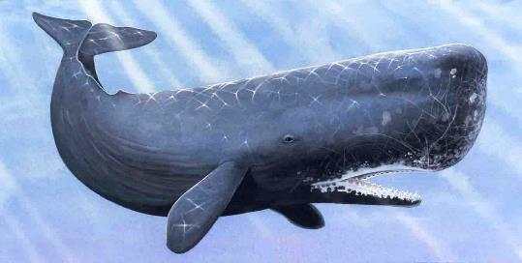
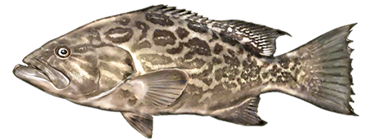
What’s Eating Jonah?
Whale
OR
Fish
Notes:
Just this week (10/27/2017) read a ‘debate’ on whether it was a WHALE or FISH… yet that not anything but a small side issue in the whole story, and it was whatever God ‘created’ for the occasion…
NASB the Lord appointed a great fish
KJV the Lord had prepared a great fish

Slide 4
Tyndale translation:
¹⁷ Bvt ye lorde prepared a greate fyshe to swalow vp Ionas.
Notes:
¹⁷ Bvt ye lorde prepared a greate fyshe to swalow vp Ionas.
Tyndale translation
IT (whatever) ‘deposited’ Jonah on the beach!

Slide 5
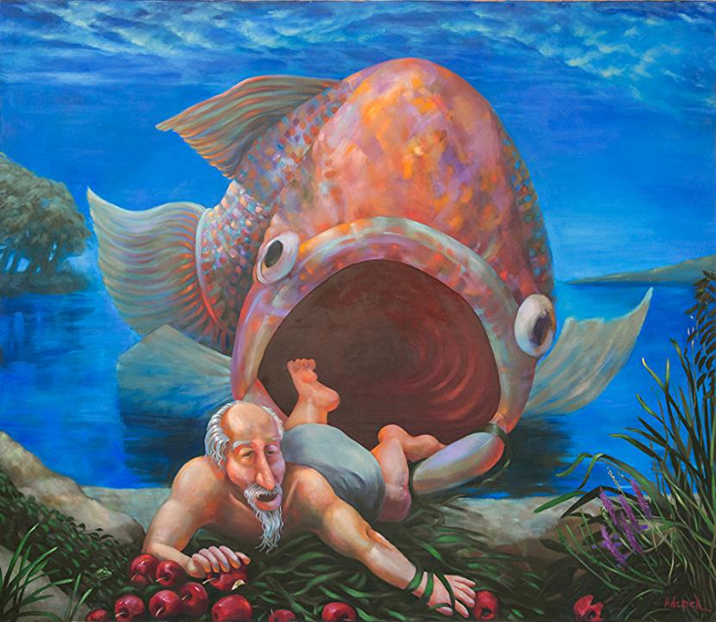
This is only PART of the story!
Notes:
Rosemarie Adcock - Work Zoom: The Arrival of Jonah at NinevehRosemarie Adcock900 × 782Search by imageThe Arrival of Jonah at Nineveh
It is interesting that the story of Jonah and Nineveh gets told but MAINLY the story dwells on Jonah and the fish.
→ Some have moved beyond that unto the story of Jonah and the Vine. The NT DOES talk about the story of Jonah, but doesn’t emphasize those events.
First, of course it the foreshadowing of Jesus in the grave and rising again. As Jonah in the belly of the great fish..

Slide 6
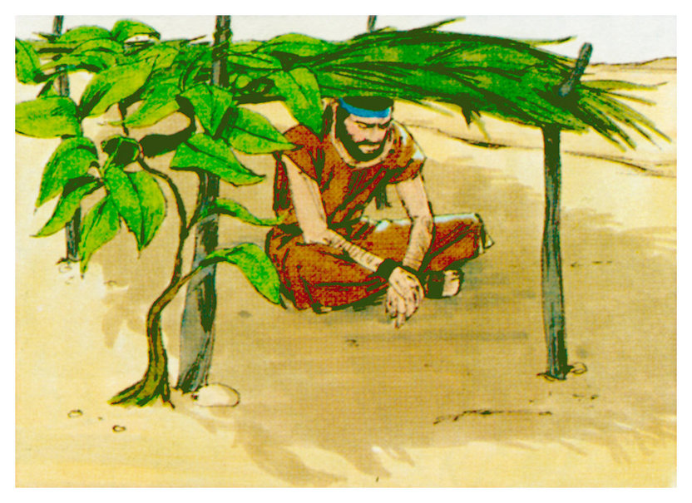
How Did Jesus
Use this story?
The Vine and the Worm
Notes:
Some – the plant that withered and angered Jonah –
Yet the whole of the story is one of our great stories –
The NT DOES talk about the story of Jonah, but doesn’t emphasize those events.
First, of course it the foreshadowing of Jesus in the grave and rising again. As Jonah in the belly of the great fish..
THEN Jesus used the story to talk about one’s relationship with God and the need of repentance. Matt. 12:41 (cp also Luke 11:30-32).
→ Nineveh – that Great City

Slide 7
Nineveh the Great City
GOD
GOD
Jonah 1:2; 3:2, 3; 4:11
Notes:
Lessons from Jonah
When we think of ‘Nineveh’, most think of two bible events: The Assyrian captivity (with Nineveh being the capital of the Assyrian empire) and the story of Jonah. Two other prophets dealt particularly with the destruction of Nineveh and the Assyrian empire: Zephaniah and Nahum. The actual fall of Nineveh/Assyria came in 612.
The story of Jonah take place earlier and shows us the longsuffering and righteousness of God in judgment! Yes, the judgment came, but God was more than patient and fair (using ‘our standards of such’).
1:2 the great city of Nineveh
3:2 go to Nineveh the great city
3:3 Nineveh was an exceedingly great city
4:11 Nineveh, the great city in which there are more than 120,000 persons who
→ AN ANCIENT CITY

Slide 8
Nineveh the Ancient City
GOD
GOD
Genesis 10:11
Notes:
Mentioned in Gen. 10:11f – Nimrod the mighty hunter –
“… From that land he went forth into Assyria, and built Nineveh…”
→ BEFORE the great empires…
and of Shinar (later Assyria / Babylon). This was in the ‘fertile crescent’ on the east bank of the Tigris river, opposite modern Mosul.

Slide 9
Great Empires
Egypt
Assyria 700’s
Babylon 600’s
Persia / Medes 500’s
Greece 300’s
Rome 100’s
Notes:
Egypt
Assyria 700’s
Babylon 600’s
Persia / Medes 500’s
Greece 300’s
Rome 100’s
and of Shinar (later Assyria / Babylon). This was in the ‘fertile crescent’ on the east bank of the Tigris river, opposite modern Mosul.

Slide 10
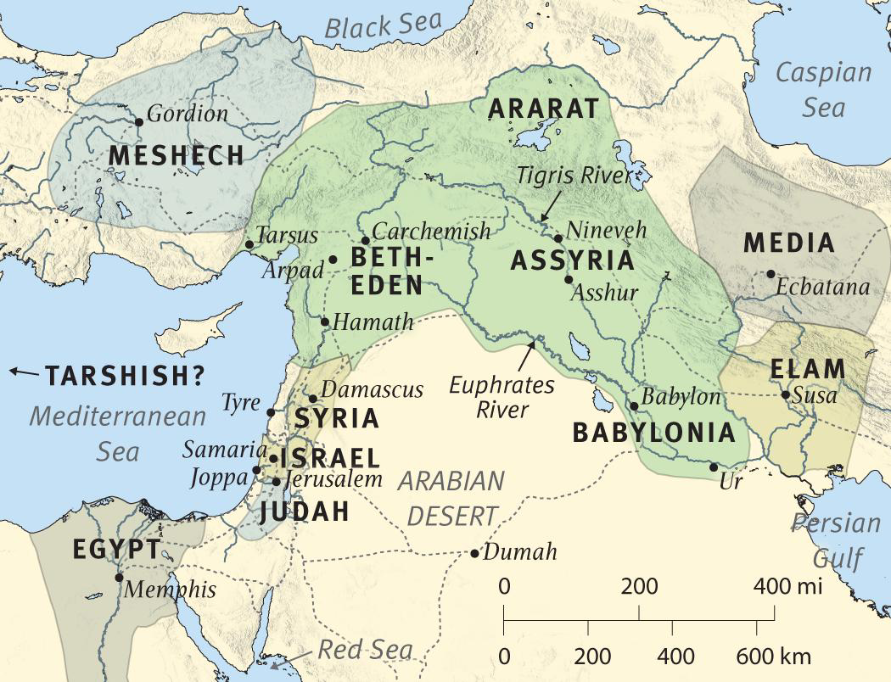
Notes:
Nineveh – The capital of Assyria… that stretch through out Middle East
Iraq, Iran, Syria, Judah, and into Egypt. And modern Turkey.

Slide 11
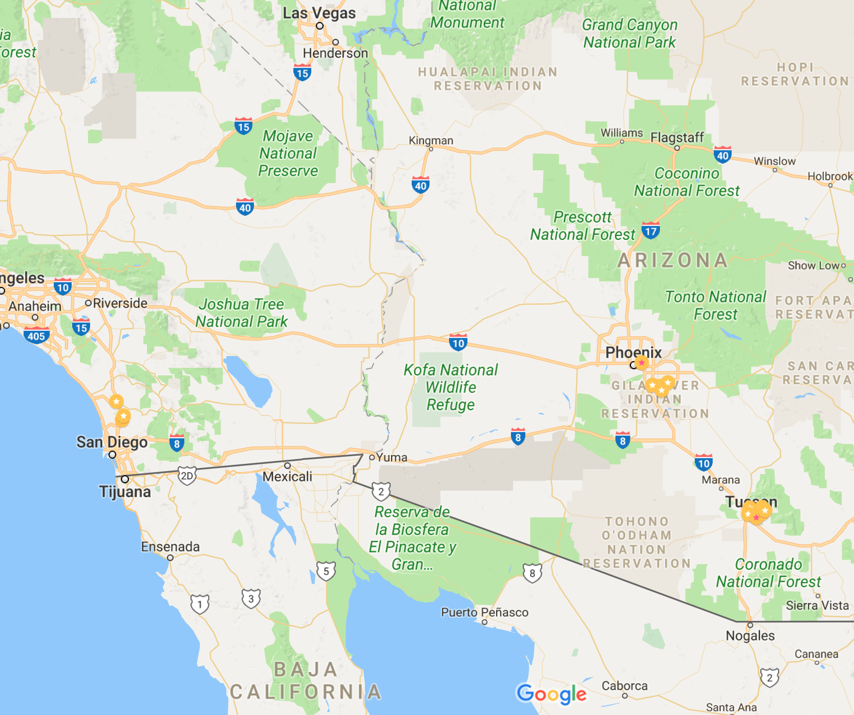
400 miles? San Diego to Tucson

Slide 12
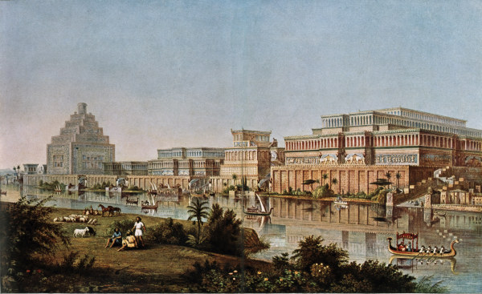
GOD
GOD
Notes:
Artist conception –

Slide 13
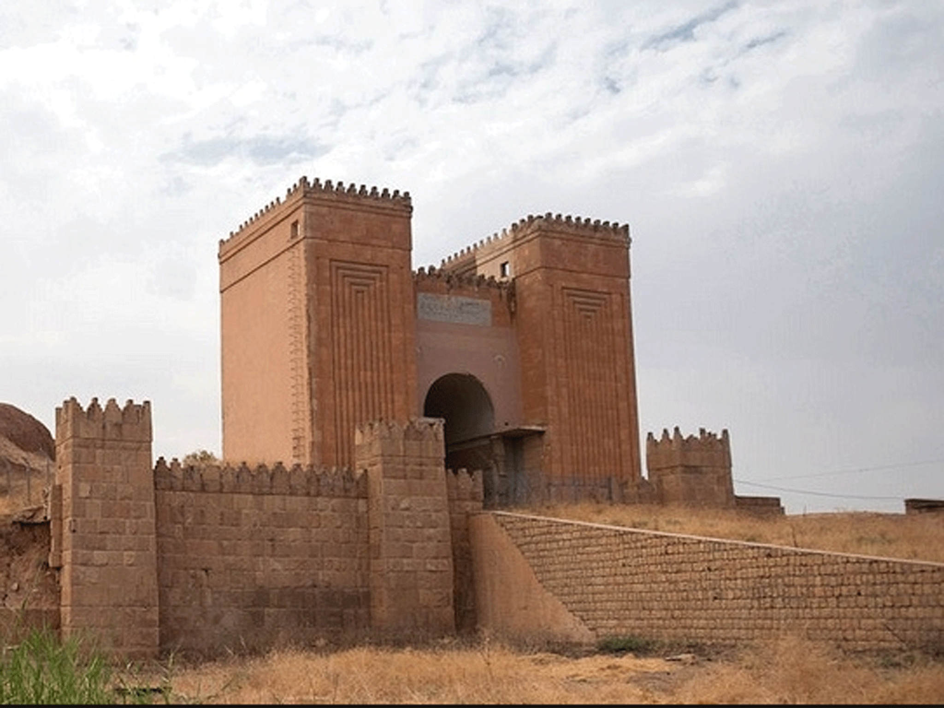
GOD
GOD
Notes:
Gates to the city – picture from a few years ago ..
(recently destroyed by ISIS)..

Slide 14
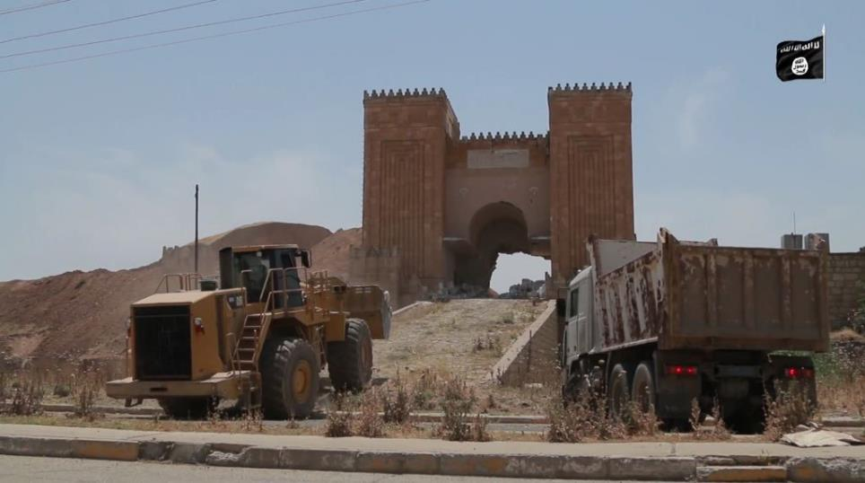
Notes:
Another picture of the gates…

Slide 15
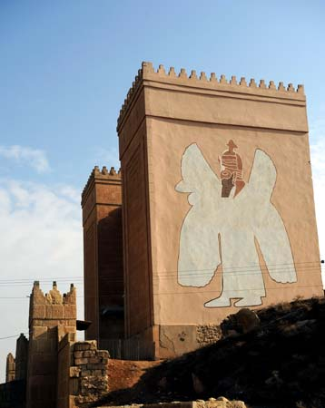
GOD
GOD
Notes:
The partially reconstructed Nergal Gate in Nineveh, Iraq.

Slide 16
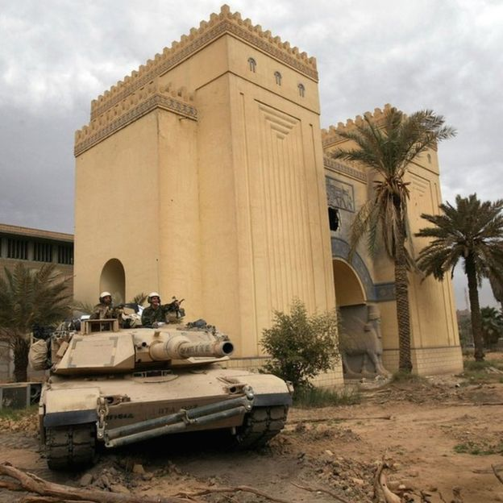
Notes:
Another gate – but occupied

Slide 17
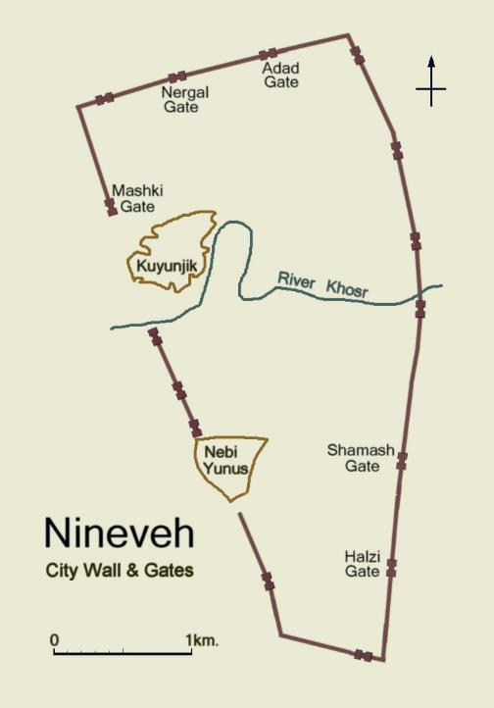
GOD
GOD
Notes:
The outline of the city walls, which are about 13 km (8 mi) in circumference
and enclose an area of about 730 ha (1800 acres), can still be traced.

Slide 18
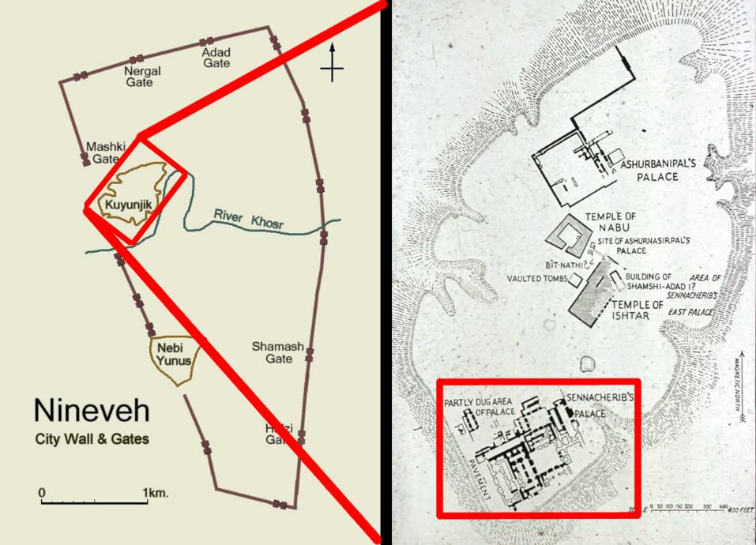
GOD
GOD
Notes:
Palaces of Ashurbanipal and Sennacherib

Slide 19
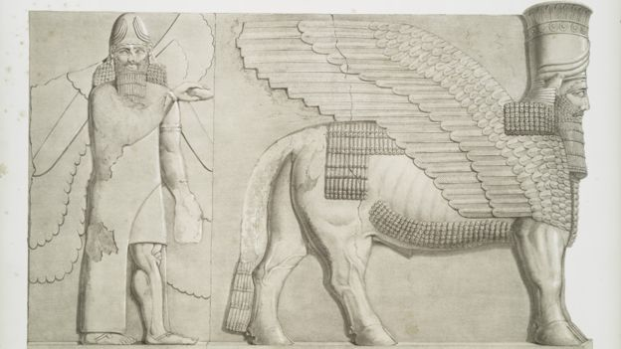
GOD
GOD
Notes:
lamassu - man, Lord of Creation

Slide 20
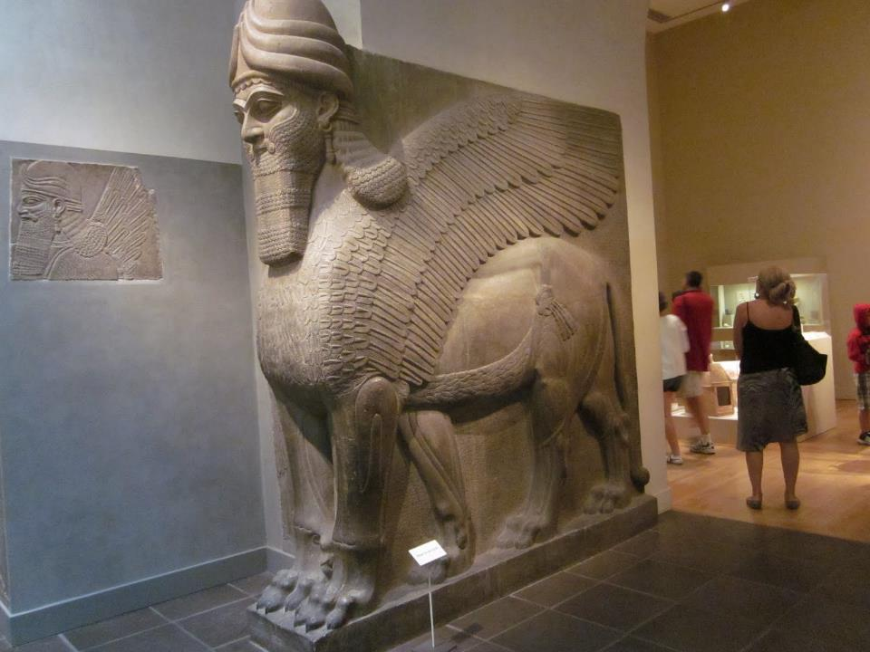
Notes:
lamassu - man, Lord of Creation

Slide 21
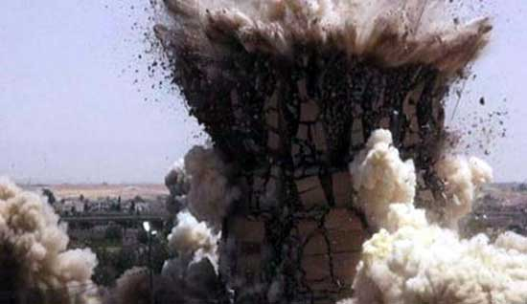
Notes:
‘thanks’ to ISIS – most of ruins have been destroyed…
YET, not erase the historical record – a great city….

Slide 22
Great City
Power
Wealth
Culture - library
Notes:
Power
Wealth
Culture - library

Slide 23
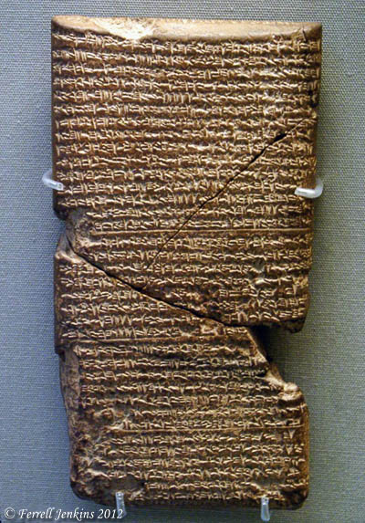
Library
26,000 tablets
Royal –
Literary –
Notes:
Library
Royal texts – ‘presidential libraries’ – wars, victories, etc…
Literary – gives us an insight to the nature and character of the Empire… divided into 5 sections…

Slide 24
Library
Literary –
Philological
Notes:
Philological (syllabaries, lexicons, grammars)
Allowed for the moderns to translate cuneiform writings! A window to the ancient world

Slide 25
Library
Literary –
Philological
Juridical
Notes:
2) Juridical (points of law and social practices)

Slide 26
Library
Literary –
Philological
Juridical
Historical
Notes:
3) Historical (annals of the kings!)

Slide 27
Library
Literary –
Philological
Juridical
Historical
Religious
Notes:
4) Religious
Epic of Gilgal and other flood stories…

Slide 28
Library
Literary –
Philological
Juridical
Historical
Religious
Scientific
Notes:
5) Scientific (500 tablets dealing with medicine – diseases described and presecriptions recorded, including some 500 different drugs to be used, ALONG WITH texts on botany, geology, chemistry, mathematics, astronomy… )

Slide 29
Nineveh Great in WICKEDNESS
GOD
GOD
Jonah 1:2
Notes:
Great in wickedness -
Jonah 1:2 "Arise, go to Nineveh the great city and cry against it, for their wickedness has come up before Me."

Slide 30
Nineveh and God
GOD
God over ALL people
GOD
Notes:
God is God over ALL peoples.
While Israel was in a special covenant relationship, the rest of humanity was NOT exempt for God and righteousness.
We have no record of any revelation, but we HAVE revelation concerning what God would condemn among the non-Jewish nations.
Amos –
Daniel – ‘weighed in the balance and found wanting’
Great oracles against the nations by the prophets –
Paul address in Romans 1 – the sins of the gentiles!
We do not have a list of specifics for Nineveh, but we have God’s statement that they were WICKED.

Slide 31
Nineveh and God
GOD
God over ALL people
God KNOWS – 1:2
GOD
Notes:
God KNOWS –
Jonah 1:2 "Arise, go to Nineveh the great city and cry against it, for their wickedness has come up before Me."

Slide 32
Nineveh and God
GOD
God over ALL people
God KNOWS – 1:2
God CARES – 4:1
GOD
Notes:
God CARES – Jonah 4:1
As with Sodom – if find 5
God had mercy upon them – caring even for the animals –

Slide 33
Nineveh and God
GOD
God over ALL people
God KNOWS – 1:2
God CARES – 4:1
God GAVE TIME to REPENT
GOD
Notes:
God GAVE TIME FOR REPENTANCE –
Jonah – sent
Later the other two prophets.
Jonah succeeded – prolonging the city, but eventually it was judged and destroyed –

Slide 34
Their Response
GOD
Jonah 3
7 mourn / fast / call on God
8 – turn from his wicked way and from the violence…
GOD
Notes:
Our Foundation:

Slide 35
Jesus said:
"The men of Nineveh will stand up with this generation at the judgment, and will condemn it because they repented at the preaching of Jonah; and behold, something greater than Jonah is here. Matt. 12:41
Notes:
It was THIS that the Lord called repentance! Matthew 12:41 "The men of Nineveh will stand up with this generation at the judgment, and will condemn it because they repented at the preaching of Jonah; and behold, something greater than Jonah is here.

Slide 36
God’s Response
God Spared them !

Slide 37
Jonah’s Reasoning:
I knew that You are a gracious and compassionate God, slow to anger and abundant in lovingkindness, and one who relents concerning calamity.
Notes:
Jonah’s reasoning (4:2)
Therefore in order to forestall this I fled to Tarshish, for I knew that You are a gracious and compassionate God, slow to anger and abundant in lovingkindness, and one who relents concerning calamity.

Slide 38
God’s Response
God Spared them !
LATER – Destroyed!

Slide 39
application?
GOD
God is still GOD !
Nations are still judged
GOD

Slide 40
application?
GOD
We MUST
be lights in the world..
call to repentance -
GOD

Slide 41
Acts 17:30
GOD
"Therefore having overlooked the times of ignorance, God is now declaring to men that all people everywhere should repent,
GOD
Notes:
Acts 17:30 "Therefore having overlooked the times of ignorance, God is now declaring to men that all people everywhere should repent,

Slide 42
2 Peter 3:9
GOD
The Lord is not slow about His promise, as some count slowness, but is patient toward you, not wishing for any to perish but for all to come to repentance.
GOD
Notes:
2 Peter 3:9 The Lord is not slow about His promise, as some count slowness, but is patient toward you, not wishing for any to perish but for all to come to repentance.

Slide 43
Acts 2:38
GOD
"Repent, and each of you be baptized in the name of Jesus Christ for the forgiveness of your sins; and you will receive the gift of the Holy Spirit.”
GOD
Notes:
Acts 2:36-39 ³⁶ "Therefore let all the house of Israel know for certain that God has made Him both Lord and Christ—this Jesus whom you crucified." ³⁷ Now when they heard this, they were pierced to the heart, and said to Peter and the rest of the apostles, "Brethren, what shall we do?" ³⁸ Peter said to them, "Repent, and each of you be baptized in the name of Jesus Christ for the forgiveness of your sins; and you will receive the gift of the Holy Spirit. ³⁹ "For the promise is for you and your children and for all who are far off, as many as the Lord our God will call to Himself."

Slide 44
GOD
GOD

Slide 45
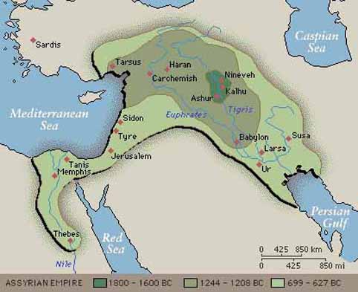
GOD
GOD
Notes:
Assyrian empire – from Thebes on the Nile, to Turkey and all the way to the Persian gulf…
Ancient Walls -

