Slide 1
GOD
GOD
Notes:
Preparing For Worship Tucson 11/12/2017
Asked to do a lesson on how we can prepare for worship…
Same time, studying the book of Hebrews in morning class ..

Slide 2
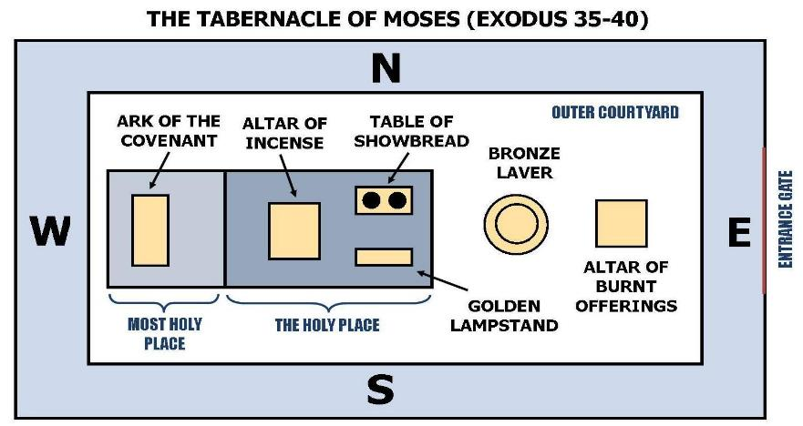
OT Worship
GOD
GOD
Notes:
OT Worship
Tabernacle – instructions of divine worship
A copy, a SHADOW, a TYPE –

Slide 3
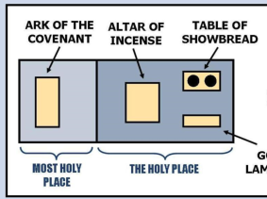
Holy of Holies – Holy Place
GOD
GOD
Notes:
Holy of Holies – where Jesus IS, mediates, functions, rules
Holy Place -

Slide 4
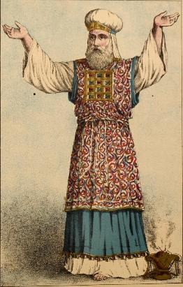
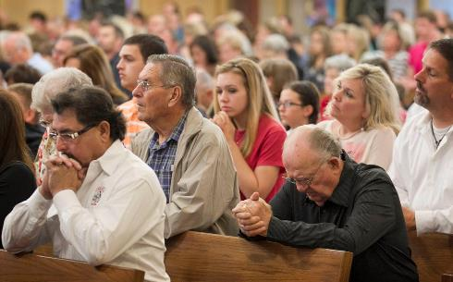
WE are today’s priests
1Peter 2:5, 9; Rev. 1:6
GOD
GOD

Slide 5
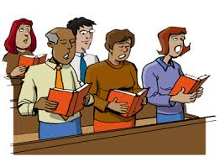
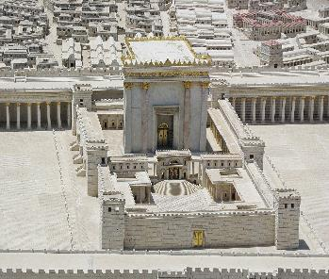
WE are God’s temple
Heb. 3:6; Eph. 2:19-22
GOD
GOD

Slide 6
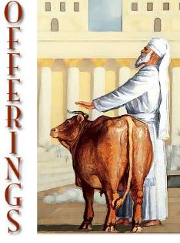
WE offer Spiritual Sacrifice
Heb. 13:15
GOD
GOD
Notes:
Fruit of our lips – Heb. 13:15: Through Him then, let us continually offer up a sacrifice of praise to God, that is, the fruit of lips that give thanks to His name.

Slide 7
Enter the holy place…
LET US… 22
GOD
GOD
LET US… 23
LET US… 24
Hebrews 19-21
Notes:
A New and Living Way
19 Therefore, brethren, since we have confidence to enter the holy place by the blood of Jesus,
20 by a new and living way which He inaugurated for us through the veil, that is, His flesh,
and since we have a great priest over the house of God,
LET US

Slide 8
Let us DRAW NEAR - 22
GOD
Hebrews 4:16; 7:25; 7:19; 10:1; 11:6
GOD
Notes:
Draw Near –
To come to / before God
NOT just at 10am on Sunday ---
BUT INCLUDES SUCH AS THE RESPONSE ..

Slide 9
Let us DRAW NEAR - 22
GOD
full assurance of faith
Hearts sprinkled
Bodies ‘washed’
GOD
Notes:
The Response of our relationship

Slide 10
Let us HOLD FAST - 23
GOD
Do you believe Jesus is the Son of God, the Christ?
Never, never, never let go
GOD
Notes:
2. HOLD FAST the confession of our hope 23

Slide 11
Let us CONSIDER- 24
GOD
Think upon, meditate
HOW to stimulate one another unto love and good deeds!
GOD
Notes:
2. HOLD FAST the confession of our hope 23

Slide 12
Done by assembling together, being together
GOD
GOD
Heb. 10:25-26

Slide 13
Friday in the OT was ‘preparation day’
GOD
LET US prepare
GOD
Notes:
Our time together IS IMPORTANT.
HOW TO PREPARE for such a solemn coming into the presence of God.
OT – ‘preparation day’ (Friday, 6th day) – to prepare for the Sabbath day.

Slide 14
As a group we HAVE
GOD
A common place
At common times
Leaders, helpers, books, lights, table, pews, sound-system, etc.
GOD

Slide 15
Collective AND Distributive (one by one together)
GOD
GOD
Notes:
BUT worship is done DISTRIBUTIVELY … collectively.
WE under NT, but we come together to remember our LORD… prayer, LS, singing, Collection, teaching/instructing.
It is above all else a ‘drawing near to God’ – an entering in to the ‘holy place to do divine service’.
We KNOW it is coming! It comes every week! Many of us don’t have to ‘think about it’ – others have not the same purpose!

Slide 16
Purpose in our hearts
GOD
GOD
Notes:
As with the collection – we give as we have purposed in our hearts
Ezra 7:10 – prepared his heart to know, to do, to teach
WE often speak of the song ‘to prepare our minds’ for the LS…
Just enlarge that THOUGHT… it begins long before 10am on Sunday

Slide 17
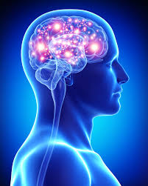
Prepare our hearts / minds
GOD
GOD
Notes:
Prepare –
FIRST – by being a prepared heart – a righteous life –
Includes knowledge of God and His doings for us
THEN - getting rest, removing obstacles and worry,
What distracts – remove!
Hindered prayer – 1Pet. 3:
Problem with brothers? – Matt. 18: go be reconciled..
→ Consider / Meditate

Slide 18
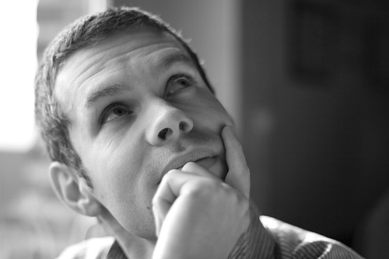
Consider Meditate
GOD
GOD
Notes:
Meditate’ –
Heb 10:24 – let us consider: to give very careful consideration to some matter—‘to think about very carefully, to consider closely.’
Prepare to NOT BE A DISTRACTION – bathroom???
Harry Mann and the locked outhouse…
→ Pray

Slide 19
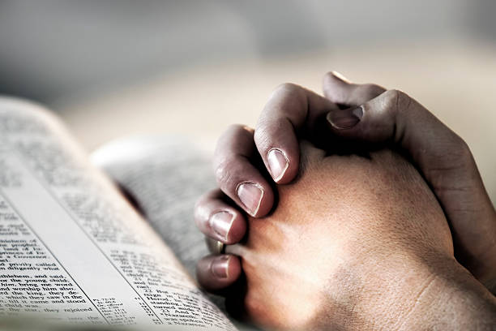
Pray!
GOD
GOD
Notes:
PRAY – about the assembly, the leaders, the people who struggle, the weak in faith…
→ Talk About It – with families / children -

Slide 20
Talk about it
GOD
GOD
Notes:
Talk About It – with families / children –
→ Sing

Slide 21
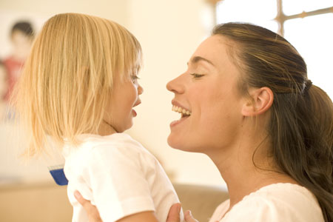
Sing
GOD
GOD
Notes:
Sing…
CW – changed the atmosphere of work! SO IN THE HOME
CD/s – taking the time to make a playlist?

Slide 22
Having Prepared – Let us assemble together and worship

