Slide 1
Jude: Contend for the Faith
Churchofchristtucson.org

Slide 2
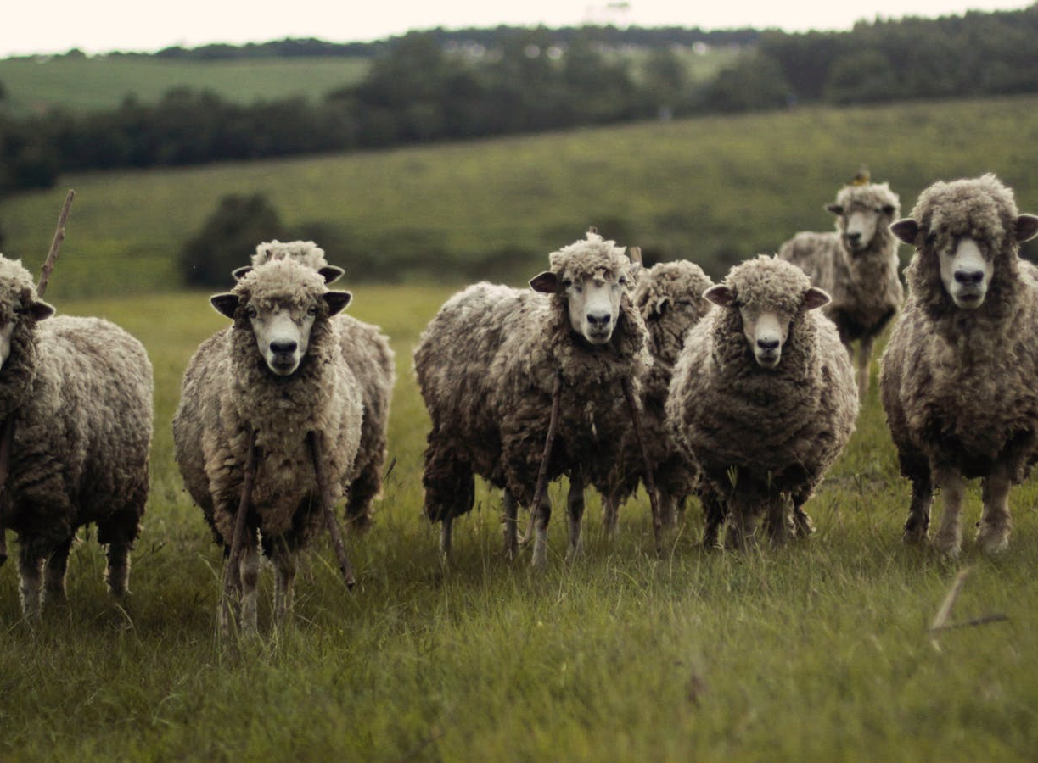
Contend for the faith
Jude 1-4

Slide 3
The Judgement seen from History
Jude 5-16
The lost generation
The angles
Sodom and Gomorrah
Cain
Balaam
Korah
Rebellion

