Slide 1
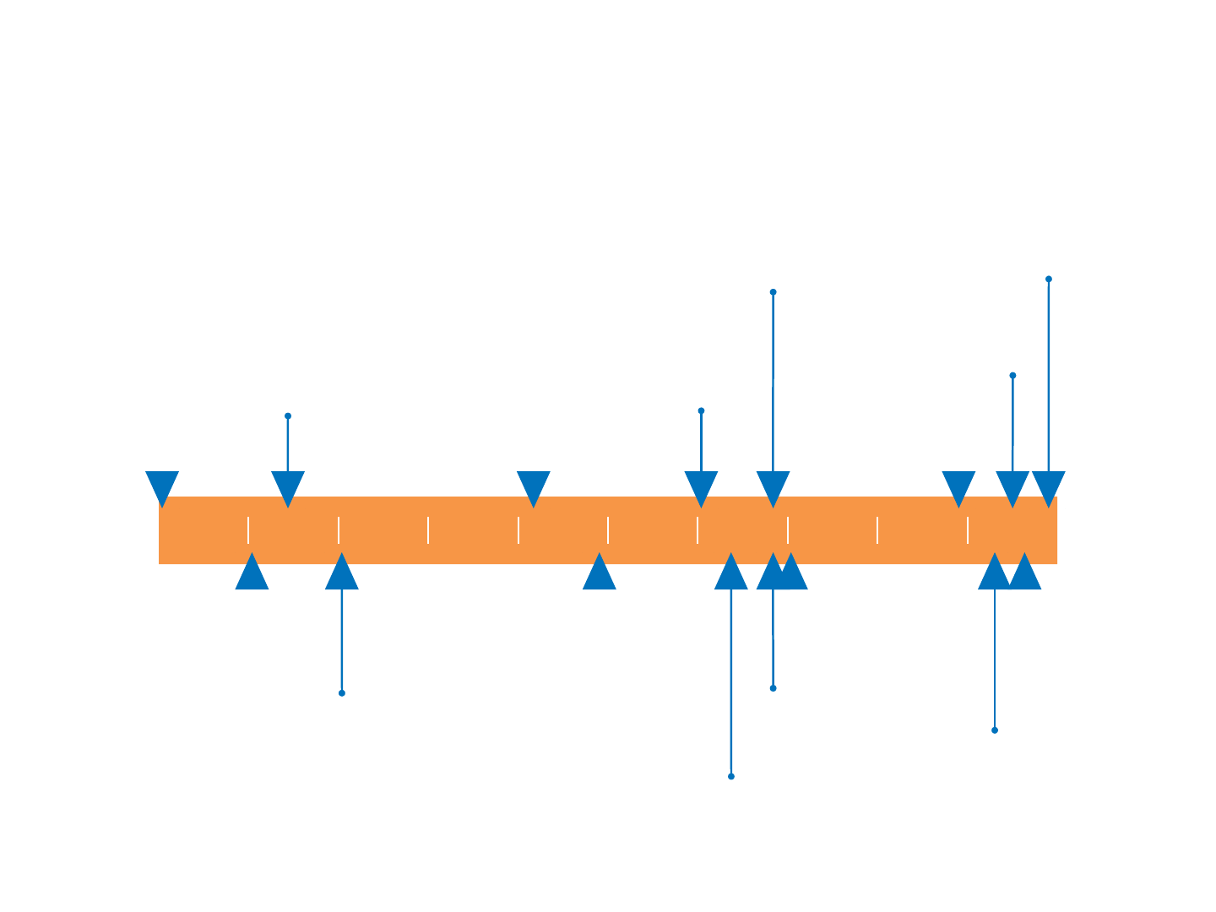

Slide 4
Why Study the Old Testament?
Churchofchristtucson.org

Slide 5
Why Study the Old Testament?
Part of God’s Revelation to Man 2 Tim. 3:16-17; Rom.15:4; Gal. 3:23-25
Helps Us Understand the New Hebrews 10:1; 1 Peter 3:20-21
Helps us Better Understand Ourselves Gen. 1:1, 26-27; Eccl. 7:29, 12:13-14; Micah 6:8
Helps Us Better Understand God Gen. 3:21-23; Habakkuk 1:13; Exodus 34:6-7

