Slide 1
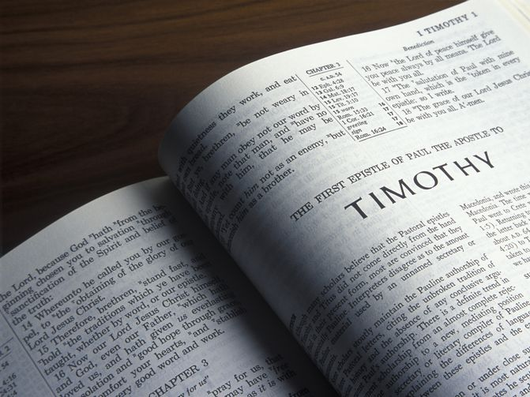
Publicly Known
1 Timothy 4:12-16
Churchofchristtucson.org

Slide 2
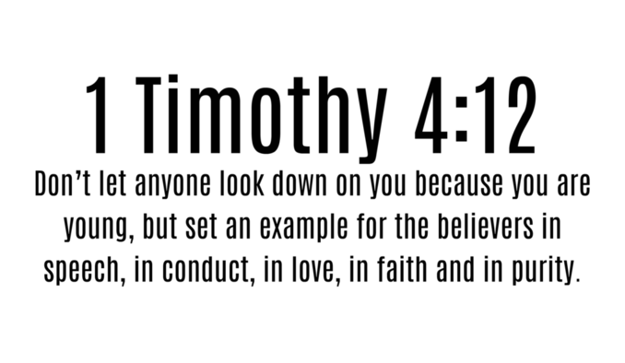

Slide 6
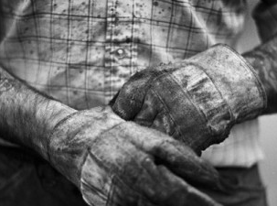

Slide 7
