Slide 1
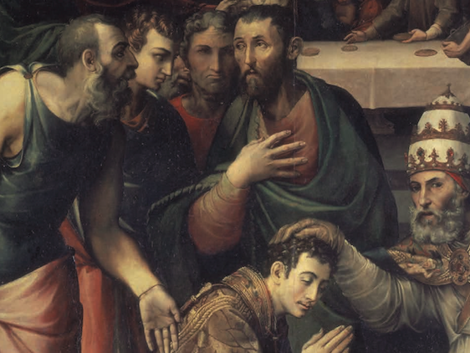
Laying on of Hands 1 Timothy 4:14
Churchofchristtucson.org

Slide 2
Laying on of Hands
What are the gifts?

Slide 4
Laying on of Hands
What are the gifts?
Acts 1:26-2:4; Acts 2:5-8; Acts 3:3-8

Slide 5
Laying on of Hands
What are the gifts?
What were the purpose of the gifts?

Slide 6
1 Corinthians 12:8-10

Slide 7
Laying on of Hands
What are the gifts?
What were the purpose of the gifts?
What was the laying on of hands?

Slide 8
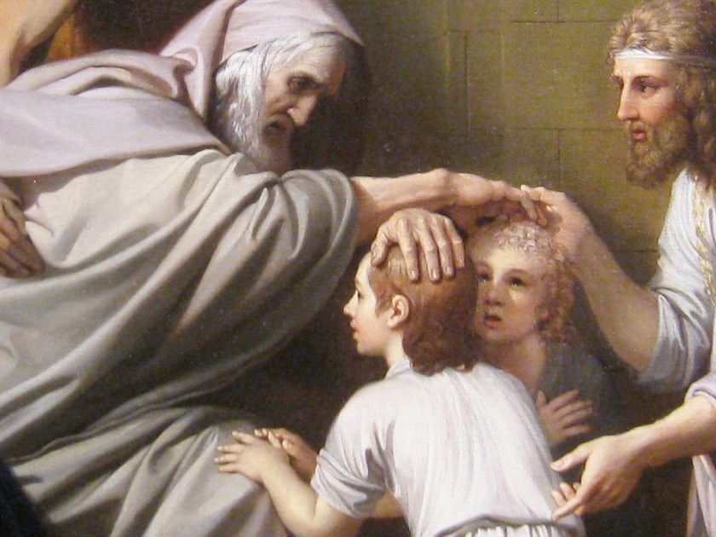
Gen. 48:14-15

Slide 9
Laying on of Hands
What are the gifts?
What were the purpose of the gifts?
What was the laying on of hands?
Does this still happen today?
1 Corinthians 13:8-10

