Slide 1
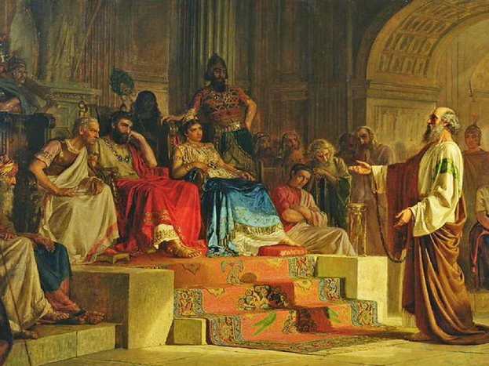
Out of Your Mind
CHURCHOFCHRISTTUCSON.ORG

Slide 3
Out of Your Mind
Truth Exist (Acts 26:25b) John 18:38; John 14:6; John 8:31-32; John 1:1-3, 14

Slide 4
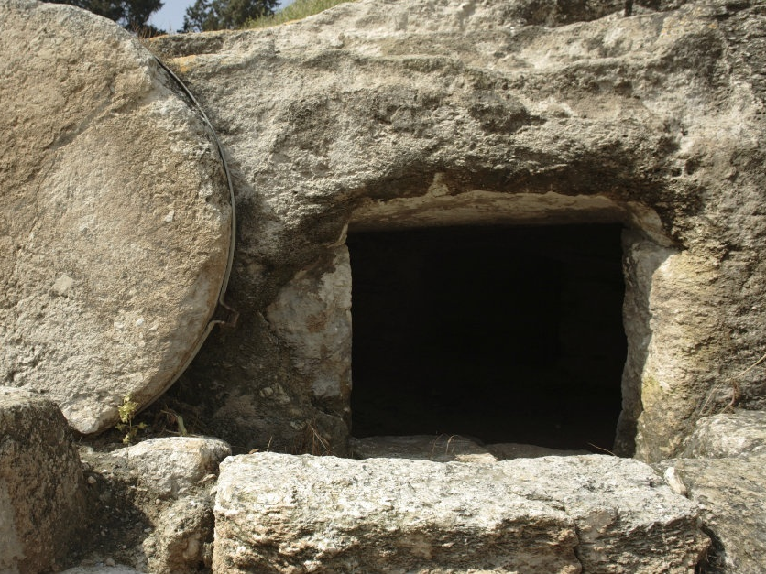

Slide 5
Out of Your Mind
Truth Exist (Acts 26:25b)
God is God (Acts 26:28) Romans 1:4; Genesis 1:1, 27; Matthew 22:29

Slide 7
Out of Your Mind
Truth Exist (Acts 26:25b)
God is God (Acts 26:28)
Jesus is the Only Way (Acts 26:16-18) Acts 4:12; John 10:9; 1 Timothy 2:5

Slide 9
Out of Your Mind
Truth Exist (Acts 26:25b)
God is God (Acts 26:28)
Jesus is the Only Way (Acts 26:16-18)
The World Knows These Truths Romans 1:20-21; Acts 17:30

