Slide 1
Churchofchristtucson.org

Slide 2
Why Do We Need Jesus?
Because religion is not the answer Duet. 7:4; Lev. 9:5, 18:3
Moral codes are not the answer Daniel 6:6-7
Following your heart is not the answer Prov. 16:25
Just doing good is not the answer Isa. 5:20; Titus 3:5

Slide 3
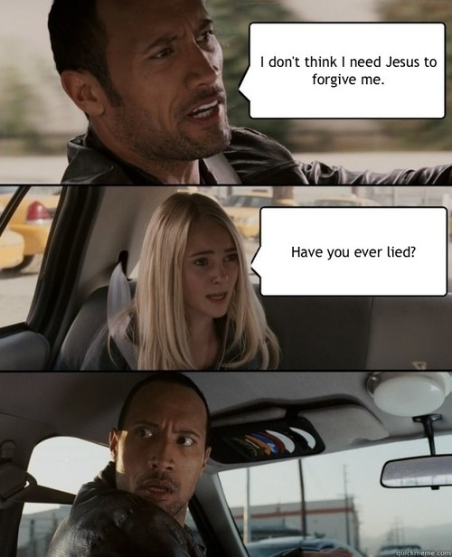
Doing Good is Not the Answer

Slide 4
Why Do We Need Jesus?
A private faith will not save us James 2:14-15, 2:19; John 12:42-43

Slide 6
Why Do We Need Jesus?
Explained God to Us John1:8; Matt. 9:36, 6:5, 7:22-23; John 12:48; Luke 19:10
Gave us truth Jude 3; John 17:17; John 1; Matthew 11:28; John 14:6
To save us Isa.59:2; Rom. 3:23; Heb. 10:4; 1 Peter 3:18ff

