Slide 1
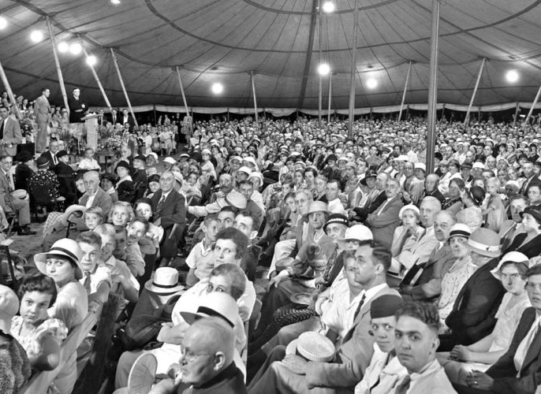
How to Make Our Gospel Meeting a Success!
Churchofchristtucson.org

Slide 2
What Can I Do to Make This Meeting Successful?
Attend Every Service Hebrews 10:23-25; Ephesians 4:16
Invite People You Know 2 Timothy 2:2; Proverbs 11:30
Not Only Invite, But Bring Acts 10:21-27
Welcome Everyone Philippians 2:4; James 2:1-7

Slide 3
What Can I Do to Make This Meeting Successful?
Sing! Psalm 100:1-5
Pay Attention Acts 10:33
Come Early Psalm 69:9a
Pray for the Meeting Colossians 4:3; 2 Thessalonians 3:1

Slide 4
What Do We Do After the Meeting?
Follow-Up 1 Corinthians 3:6; Galatians 6:9
Get Copies of the Lessons Ecclesiastes 11:6
Make up Your Mind to Try Harder Next Meeting Luke 15:4; 1 Thessalonians 4:1

