Slide 2
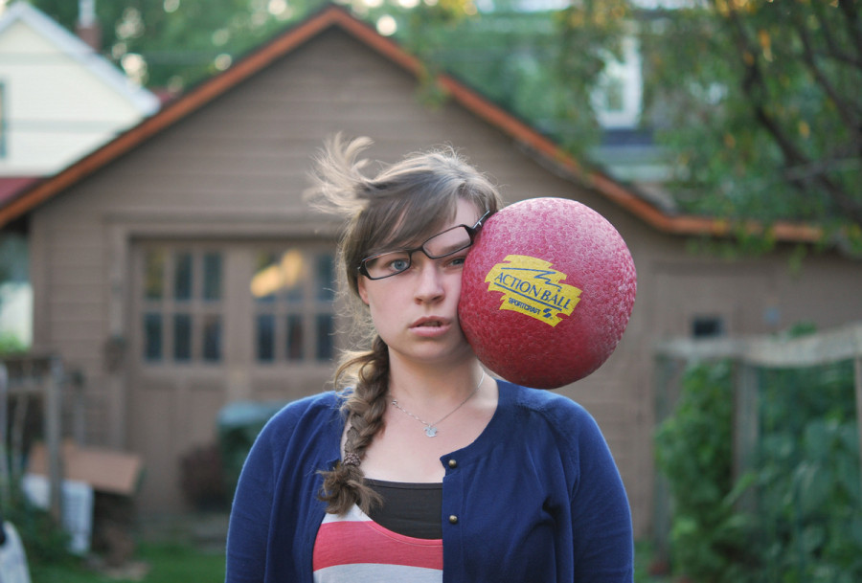
Wrong Place, Wrong Time
Churchofchristtucson.org

Slide 3

Wrong Place, Wrong Time
Eve in the Garden Gen. 2:15-17, 3:1-7

Slide 4
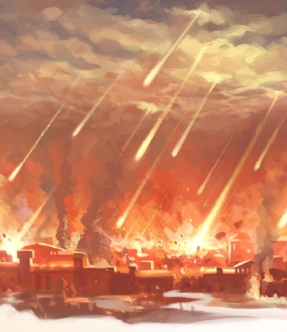
Wrong Place, Wrong Time
Lot in Sodom Gen. 13:8-13, 19:12-14

Slide 5
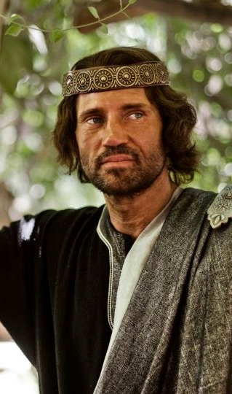
Wrong Place, Wrong Time
David at Home 2 Sam. 11:1-5, 14-15

Slide 6
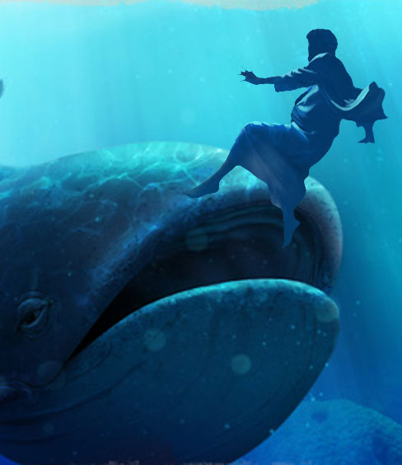
Wrong Place, Wrong Time
Jonah at Sea Jonah 1:1-10, 14-16

Slide 7

Wrong Place, Wrong Time
Peter by the Fire Luke 22:31-34, 54-62

Slide 8
What must I do to be saved? Acts 16:30
Believe in Jesus; John 8:24
  Repent of Sins; Luke 13:3; 5
    Confess our Faith in Christ; Matt. 10:32-33
      Be Baptized for the Remission Of Sins; Mark 16:16; Acts 2:38
        Live Faithfully; Rev. 2:10

