Slide 1

Churchofchristtucson.org

Slide 2
Knowing What God Wants
The Pillars of Authority
  God is creator Gen. 1:1
  Christ is King Acts 2:29-36; Col. 1:18
  The Holy Spirit is the revealer of the mind of God 1 Cor. 2:10-13
  Man is God’s creation and therefore not in a position of authority Jer. 10:23

Slide 3


Slide 4
Knowing What God Wants
How Communication Works
  We are made in the image of God Gen. 1:27
    Reason
    Think
    Logic
    Communicate
    All come from God
  We can tell, show, or imply

Slide 5


Slide 6
Knowing What God Wants
God can tell us something
  Commands (ex. The 10 Commandments)
  These are direct statements about what is or is not to be done
    Can be negative Eph. 5:7-8
    Also, positive Luke 22:19
    Can be generic Matt. 28:19

Slide 7
Knowing What God Wants
God can show us something
  Examples
  Like commands, examples show us approved practices by God and practices not approved by God
    The Lord’s Supper on the first day of the week Acts 20:7
    Treating Gentiles differently than Jews Gal. 2:11-14
  Apostolic example was taught in every church Phil. 3:17, 4:9; 1 Cor. 4:16-17

Slide 8
Knowing What God Wants
God can imply something
  Necessary inference
  Something that is not explicitly said but implied by the text.

Slide 9
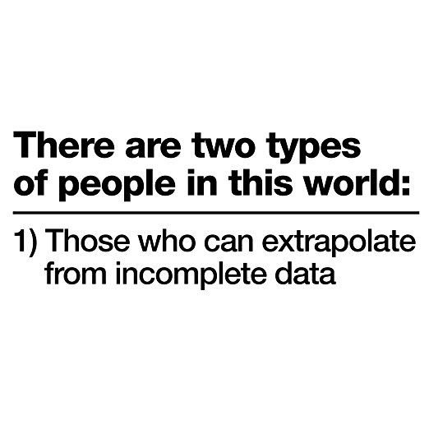

Slide 10
Knowing What God Wants
God can imply something
  Necessary inference
  Something that is not explicitly said but implied by the text.
  Jesus taught by inference Matt. 22:23-33
  There are certain things we can learn from the scriptures though not explicitly said
    Acts 8:35-36, 38
    Hebrews 10:25

Slide 11
Knowing What God Wants
God can imply something
  However, we must understand the difference between a necessary inference and a forced conclusion
    Acts 8:38 – Necessary inference
    Acts 16:14-15, 31-33
      The forced conclusion there is that infants were included in the house.

Slide 12
What must I do to be saved? Acts 16:30
Believe in Jesus; John 8:24
  Repent of Sins; Luke 13:3; 5
    Confess our Faith in Christ; Matt. 10:32-33
      Be Baptized for the Remission Of Sins; Mark 16:16; Acts 2:38
        Live Faithfully; Rev. 2:10

