Slide 1
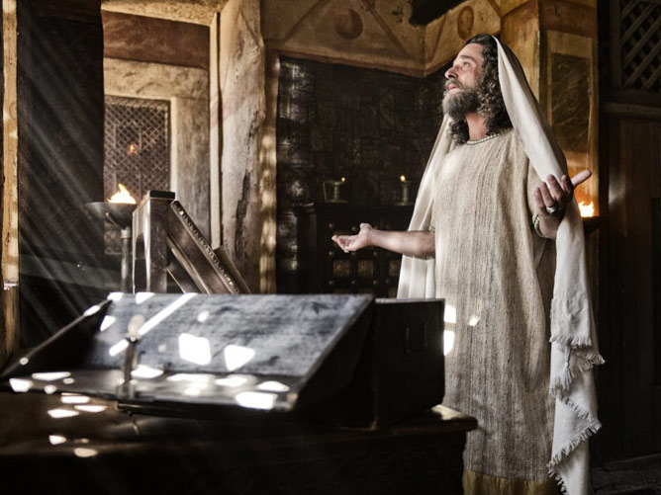
Living in Babylon
Churchofchristtucson.org

Slide 2
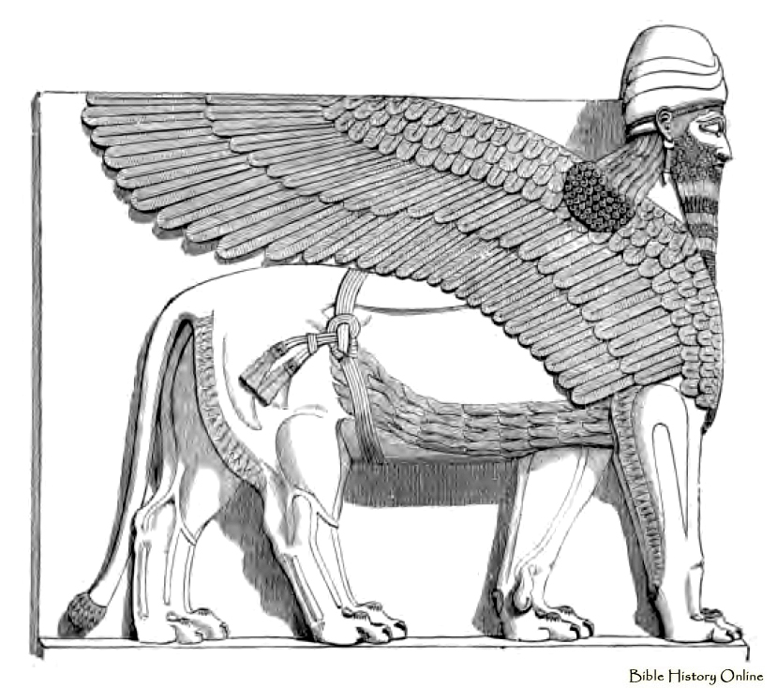
Living in Babylon
He Made Up His Mind Daniel 1:8
  God has called us to be separate and holy 1 Peter 2:9; John 17:15-16
  Must do so in a way that glorifies God Dan. 1:8-10, 18-21; Romans 12:8
  What are we willing to give up? 1 Cor. 10:23; Romans 12:1-2

Slide 3
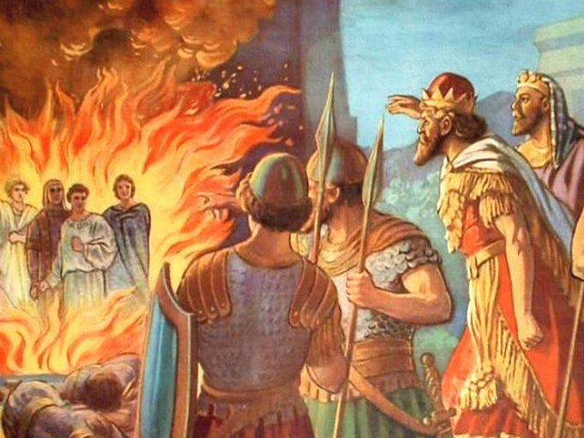

Slide 4
Living in Babylon
Faithful Under Fire Daniel 3
  We are suppose to expect trials John 17:14; 2 Tim. 3:12
  The Idol and Fire Dan. 3:1, 4-6; 13-18; 28-30
  Rejoice in it James 1:2-3; Heb. 11:8-9, 11, 17-19; Acts 5:41; Acts 7:54, 57, 60

Slide 5
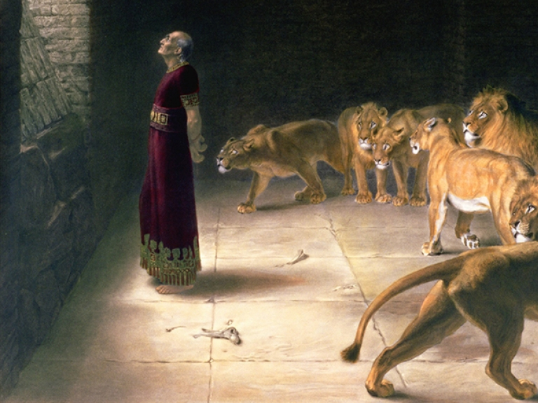

Slide 6
Living in Babylon
Did What Was Right Daniel 6 & 9
  Prayer and the Lions Dan. 6:16-24
  Was faithful to God when it seems all else had forgotten Dan. 9:1-6, 20-25
  One person can make a difference!
    Ezek. 14:14 –Does God know your name?
    Rev. 3:15-16
    James 4:17

Slide 7
What must I do to be saved? Acts 16:30
Believe in Jesus; John 8:24
  Repent of Sins; Luke 13:3; 5
    Confess our Faith in Christ; Matt. 10:32-33
      Be Baptized for the Remission Of Sins; Mark 16:16; Acts 2:38
        Live Faithfully; Rev. 2:10

