Slide 2
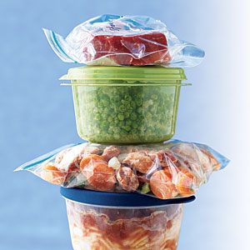
Leftovers for God

Slide 3
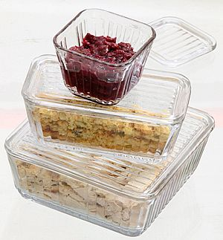
Leftovers for God
Mal 1:6-8
● What are your priorities?
Luke 17:5

Slide 4
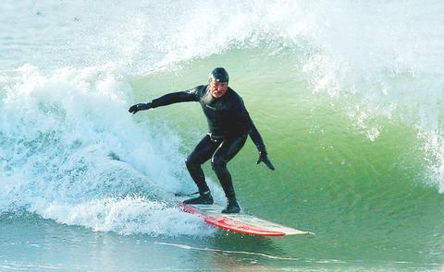
Dale Webster

Slide 5
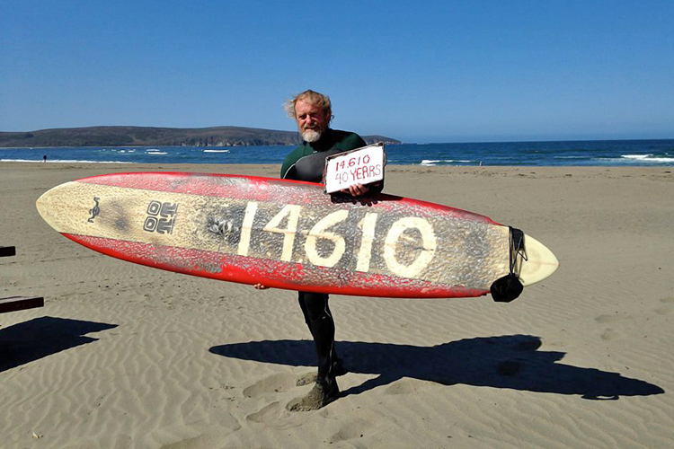
Every day for over 40 years!

Slide 6
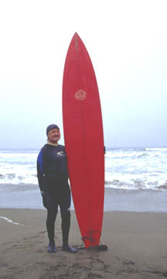
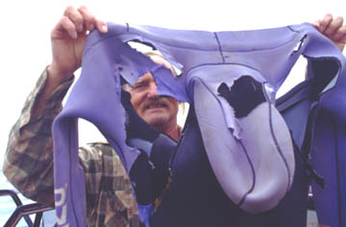
Every day!

Slide 7
Leftovers for God
Mal 1:6-8
● What are your priorities?
Luke 17:5
● Sins of omission
Mat 25:34, 35-36, Tit 2:1-6
● How are you dealing with worldliness?
1Cor 6:12
● What is your example to those around you?
2Cor 6:3, Mat 27:27-37, Mal 3:8-12
Are YOU giving God the leftovers?

Slide 9
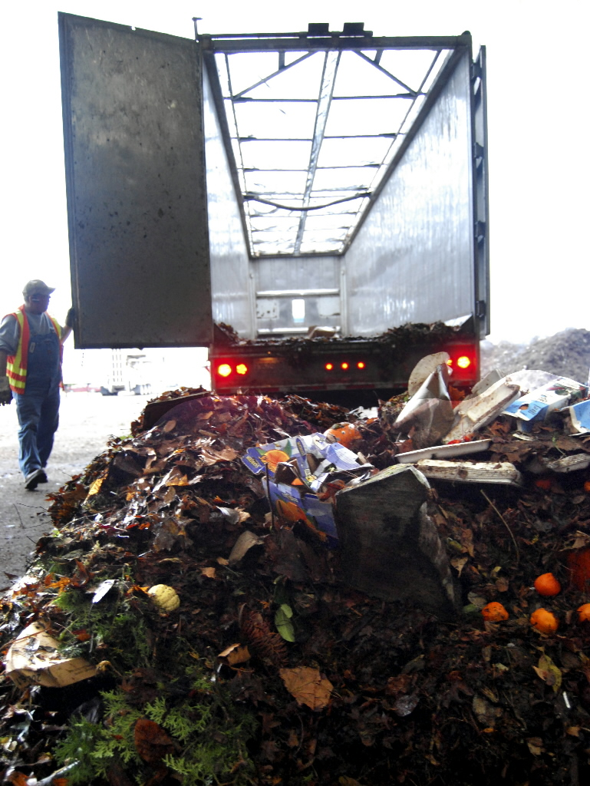

Slide 10
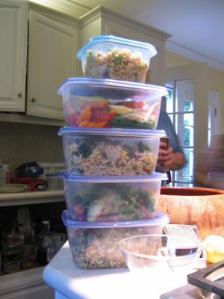

Slide 11
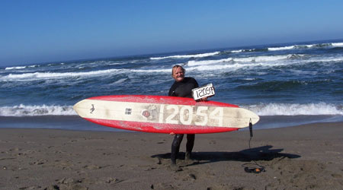
Every day for 33 years!

