Slide 1
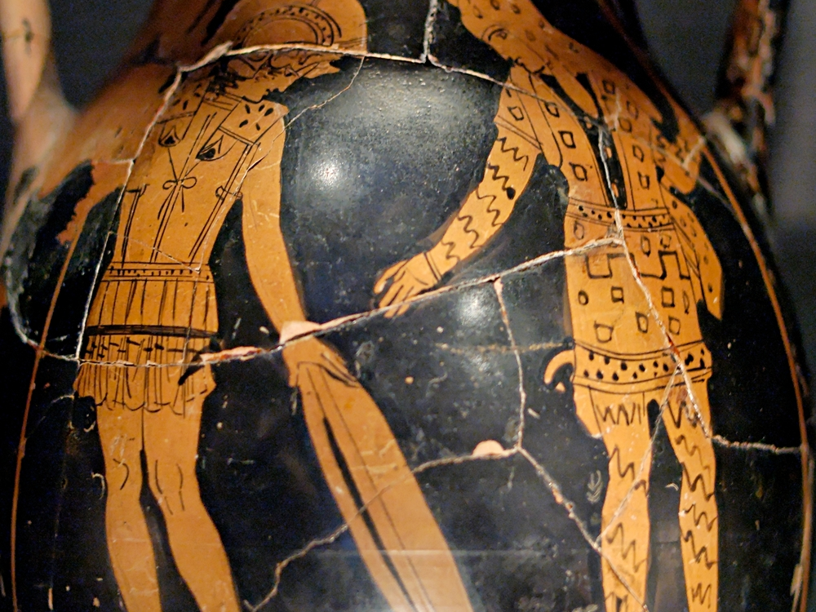

Slide 2

Friendship
Churchofchristtucson.org

Slide 3
Friendship
Proverbs 18:24
Friendship
  Philos – a friend; someone dearly loved (prized) in a personal, intimate way; a trusted confidant, held dear in a close bond of personal affection.
  Adelphos – meaning a brother/ sister. It became the exclusive word to use for a fellow Christian.
  Has certain characteristics Amos 3:3;Eccl. 4:9-10; Prov. 27:9, 5-6

Slide 4
Friendship
Proverbs 18:24
Friendship is multi-leveled:
  Requires three components
    Association
    Loyalty
    Affection
  Corresponding to that there are three levels of friendship

Slide 5
Friendship
Proverbs 18:24
Friendship is multi-leveled:
  Friendship as association only Matt. 20:13; 22:12; 26:50
  Friendship as association + loyalty 1 Kings 4:5;1 Chron. 27:33; Prov. 18:24; John 19:12
  Friendship as association + loyalty + affection 1 Sam. 18:1-4; Phil. 4:1, 15-20

Slide 6


Slide 7
Friendship
Proverbs 18:24
Friend of God:
  Abraham was called the “friend of God” by his faith and obedience 2 Chronicles 20:7; James 2:23 (Hebrews 11:8)
  Those who keep God’s covenant or word are called His friends Psalm 25:14
  By contrast one can be a friend of the world which excludes all possibility of friendship with God James 4:4; 1 John 2:15

Slide 8
Friendship
Proverbs 18:24
Friend of God:
  We become friends with God when we become true friends with His Son
  We must be on the same path Matthew 4:19; 1 Corinthians 11:1
  We must be loyal to Him Matthew 10:32-33
  We must love Him John 15:12-15

Slide 9
What must I do to be saved? Acts 16:30
Believe in Jesus; John 8:24
  Repent of Sins; Luke 13:3; 5
    Confess our Faith in Christ; Matt. 10:32-33
      Be Baptized for the Remission Of Sins; Mark 16:16; Acts 2:38
        Live Faithfully; Rev. 2:10

