Slide 1
Churchofchristtucson.org

Slide 2
Godliness
Holiness = Godliness
Romans 8:12-16
Godliness is living a life pleasing to God Romans 12:1-2
Titus 2:11-14; 1 Timothy 4:6-8
Notice the emphasis on training
Notes:
Romans 8:12-16 – Godliness in a nutshell. Does not use the word. We are pursuing the things of God.
Romans 12:1-2 – Ties back to Romans 8. We renew by pursuing the things of God and putting off the old man.

Slide 3
Notes:
Self-control is the key to the path of holiness.
Opposite = “Self-indulgence…. The quality of being “without self-control”, the inability to keep one's passions under control or to resist temptation.”

Slide 4
Self-control
Not for “self-control’s” sake
Mastering of the self and the fashioning of one’s life in the way which God desires.
2 Corinthians 9:23-27
Run’s with purpose
Self – control in all things
Everything is done to win
He is master over himself
Notes:
Self-control = Saying No

Slide 5
Notes:
Everything about a runner, or Olympic athlete’s , life is done intentionally. They are serious about victory and will do what it takes to achieve that victory.
Daily training
Intentional nutrition
Look for ways to push themselves to do better
All Takes Discipline to Do

Slide 6
Developing Our Self-control
Begins with love Matthew 22:37
Need Purpose Hebrews 12:1-3
Recognize we are responsible James 1:13-16; Hebrews 12:14
Set goals
If it is not helping us, it needs to go Matthew 5:29-30
Notes:
We look at the big picture – I am doing this with a purpose
We are responsible not only for when we sin, but also for pursuing holiness
Goals – Holiness works like a good habit. Habits are made with internality.
Be specific (Ex. I will read my bible every day for 20 minutes)
Keep track
Set a target date (66 Days seems to be a magic number for forming habits)

Slide 7
Exercising Our Self-control
Putting to death the works of the flesh
Developing the fruit of the spirit
I need to say no to sin and yes to holiness
Notes:
2 Timothy 2:5 cf. 3:16-17
I stop doing the things of the old life and work on doing the things of this new life
Again – Romans 8:13

Slide 8
SELF-CONTROL ENABLES US TO REFRAME
SELF-CONTROL ENABLES US TO REFRAIN
Notes:
Self control begins with stepping back and seeing the big picture.
What is ______ going to cost me?
When I can see the big picture then I can refrain from that temptation.
Galatians 5:19-24 – Our appetites are never satisfied! They always whisper now not later. So don’t even try, pursue God and His righteousness.

Slide 9
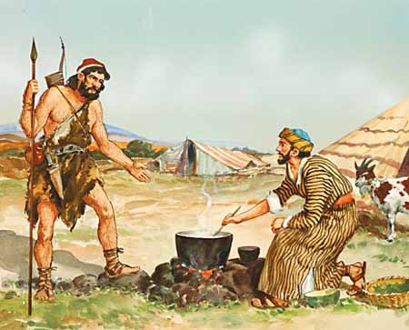
Notes:
Genesis 25:29-34
Esau could have been in the blessing, in the line of Christ, “Abraham, Isaac, and Esau.”
Had no self control and it cost him dearly
- What is your bowl of stew?

