Slide 1
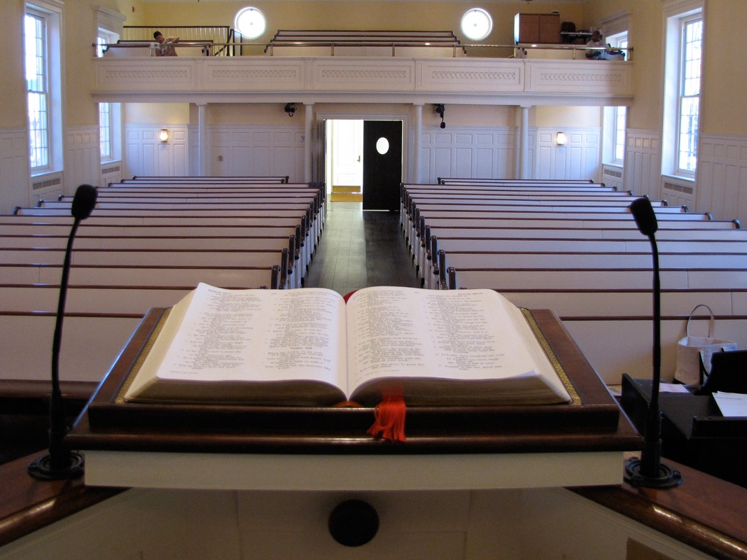
Preachers
churchofchristtucson.org

Slide 2
Preachers
Several different words used
Preacher Romans 10:14
Evangelist Acts 21:8
Minister Romans 15:16
Each describe a different aspect of the preacher's work

Slide 3
Their Work
2 Timothy 4:5, 1-2
Different from that of an Elder or Deacon
2 Timothy 4:2
Preach
Reprove
Rebuke
Exhort
Notes:
What does ministry mean? (If you were thirsty and I had a pitcher of water… I would be ministering to you. So to with the gospel, if you are thirsting for righteousness and I preach to you I am ministering the word to you.)
Their work may overlap however, it is not the same.

Slide 4
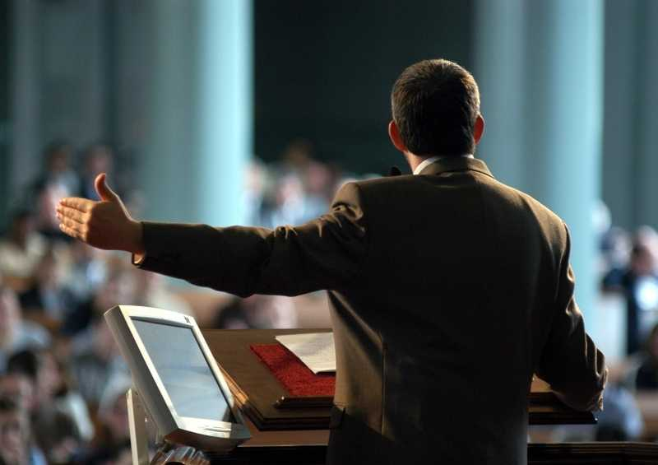
What is Involved in Preaching?
Notes:
Acts 4:2 – The resurrection was preached
Jesus authority was preached because they were preaching the gospel, what Christ had commanded them to do. Matthew 28:18-20
Acts 4:5-12
To preach the gospel to preach Christ resurrection, death, burial, and authority. To do less is to preach a different gospel.

Slide 5
Notes:
Salvation needs to be preached

Slide 6
Preach Christ
Acts 8:5
Forgiveness of Sins Acts 13:38-39
Jesus, the Son of God Acts 9:20
Death, burial, resurrection as facts to be believed 1 Corinthians 15:1-4
Commands to be obeyed Acts 2:37-41
Notes:
Acts 9:20 – A man may preach that Jesus was a great man, or that He was the greatest teacher, but that is relatively unimportant. To preach Christ as the Son of God, that makes a difference.

Slide 7
Other Considerations
Attitude 2 Timothy 2:24-26
Rebuke Acts 13:8-10
Protect the church Galatians 2:4-5
Feels the urgency of the Gospel Romans 10:11-15
The Preachers work and responsibility is the preaching of the gospel
Notes:
Protect the church – Elders have the primary duty in this however, the preacher is supposed to expose and refute false doctrine as well. It is a shared task.

