Slide 1
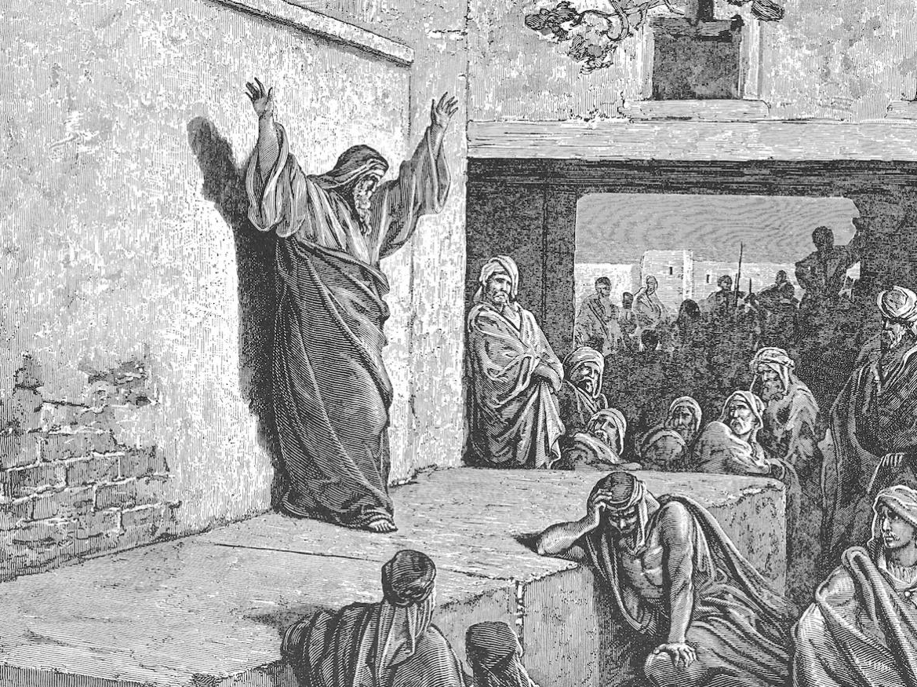
Who is like Jehovah
Churchofchristtucson.org

Slide 2
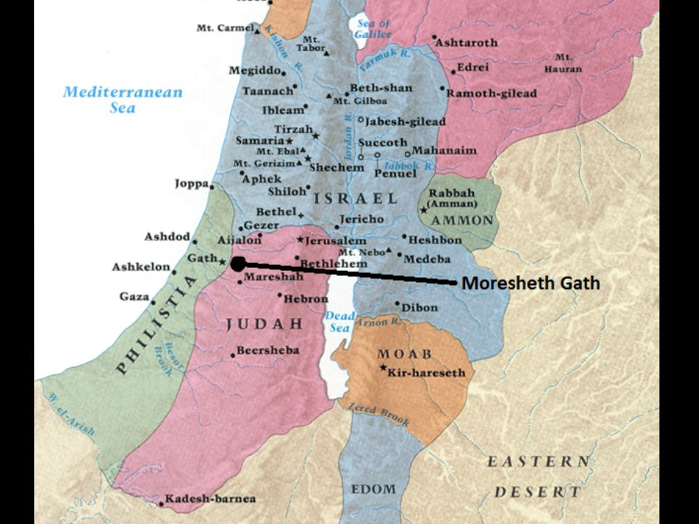
Notes:
Star – Jerusalem
X – Moresheth
It was about 22 miles (35 km) southwest of Jerusalem in the “lowland” or Shephelah region. – ESV Study Bible

Slide 3
Micah 1-3:
Message of destruction
Land is full of oppressors
Silence God’s prophets
They take from and cheat the poor
Land is full of wicked leaders
Leaders, Prophets, and priest
This judgement is inescapable

Slide 4
Micah 4: Peaceful latter days
All peoples will seek God vv.1-5
Cf. Isa. 2:2-3; Acts 2
They will be a holy nation to God vv.6-8
Captivity is happening now vv.9-13
Notes:
vv. 11-13 – It may appear as all is lost and that God’s enemies are in control but they are the ones who do not see things as they are. God’s people will be victorious in the end!

Slide 5
Micah 5: The redeemer comes
A redeemer is coming vv.1-5a
vv.2 is quoted in Matthew 2:6
He will be their peace vv.5b-6
He will be their strength vv.7-9
He will be their victory vv.10-15
Notes:
vv. 2 Eff-ruh-thuh
vv. 5Assyrian – Historical enemy of God’s people. Northern captivity. They are a stand in or a symbol for God’s enemy in all times.

