Slide 1
Churchofchristtucson.org

Slide 2
IN the Beginning:
The beginning of creation:
The first cause Gen. 1:1; Rev. 4:11
Mankind
Made in the image of God Gen. 1:26-27
Created not evolved Matt. 19:4-6

Slide 3
IN the Beginning:
The beginning of Sin:
Genesis 3:1ff
The lie
The fall
The consequences
The rest of the bible will be about correcting this sin problem

Slide 4
IN the Beginning:
The Beginning of Hope:
Genesis 3:15
Genesis 12:1-3
Acts 3:24-26

Slide 5
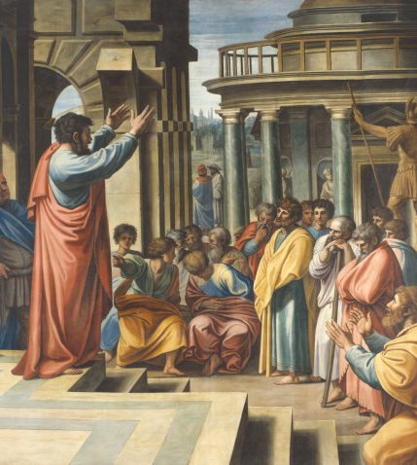
Acts 17 Applications
Begins with creation 17:24
Shows them purpose 17:27
Call to repent 17:29-31

