Slide 1
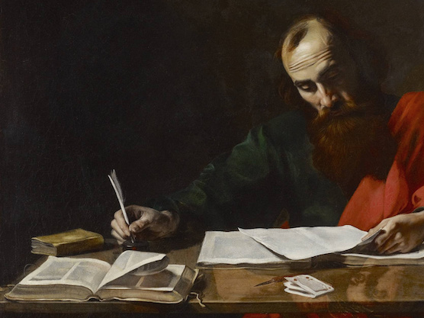
Imperfect conversation
Churchofchristtucon.org

Slide 2
The lion in the street:
Proverbs 22:13
We’re paralyzed with fear at times:
I don’t know enough
What if I say the wrong thing
I had a bad experience before
Paul was not without his fears and imperfections Phil. 3:12; 1 Tim. 1:15-16
Notes:
Fear: unfounded or not
“If you want to conquer fear, don’t sit at home and think about it. Go out and get busy.” – Dale Carnegie

Slide 3
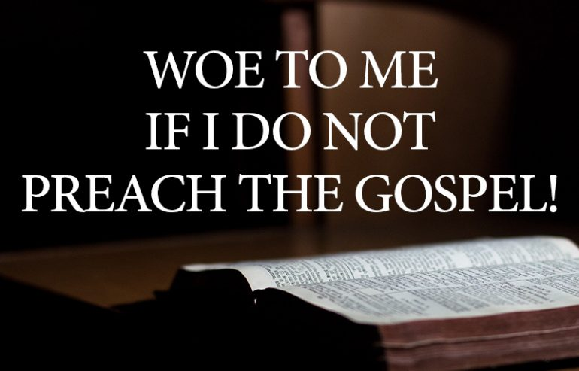
1 Corinthians 9:16

Slide 4
Paul our example:
Three Things Paul Did:
1 Thessalonians 2:1-12
Had humility vv.1-4
Was guided by the Word vv. 5-8
He followed up vv. 9-12
Notes:
Context: Started during the second preaching journey (Acts 17:1-4), quick converts. Paul had to leave them after only 3 weeks due to Jewish persecution.
1 Thess. 1:2-7 – refers back to their conversion
Guided by the word: 1 Corinthians 2:4-5

Slide 5
Scripture applied
Notes:
An imperfect conversation about faith will forever be better than no conversation whatsoever.
Paul did not say that I came to you in perfection, but in humility. He had the desire and felt the urgency to tell others about the Gospel and that is an example needed to be followed.
Sincerity/Humility – Lean on the Word – Make yourself available

