Slide 1
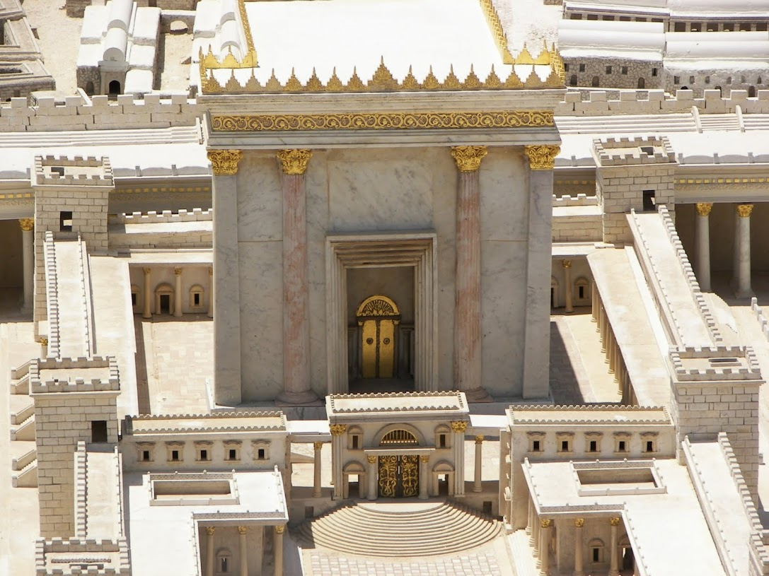
Fig trees and religion
Churchofchristtucon.org

Slide 2
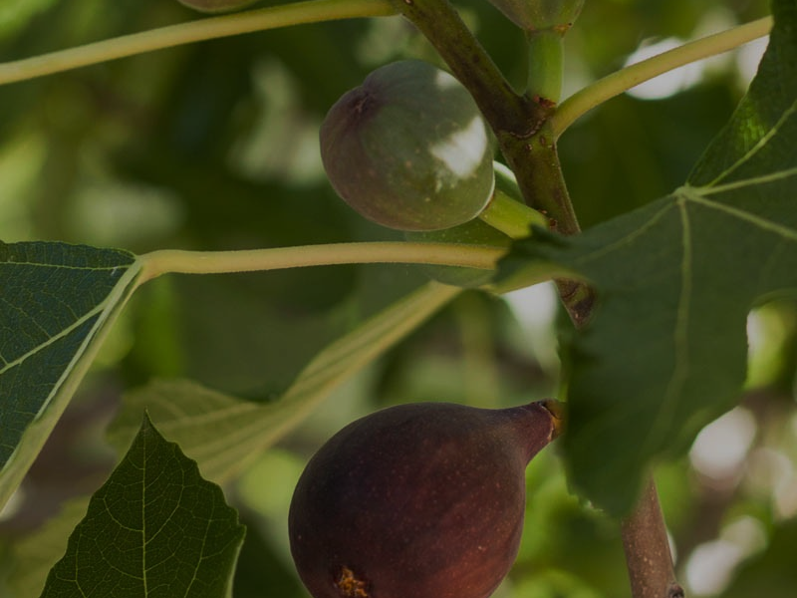
No fruit
Mark 11:11-14
The Fig Tree
Was a often represented Israel in the OT Hosea 9:10
The tree is being used by Jesus here as the same symbol
Not the season
But, gave the appearance of having fruit
Notes:
Setting: Jesus has come up to the region and city of Jerusalem for the last time before His crucifixion. This section of text takes place after the triumphal entry.
Not the season – The small figs which came in late spring/ early summer (June) often proceeded the leaf or were ripe as the tree was leafing. The larger ones came when the tree was full leafed and later in the season, around August.

Slide 3
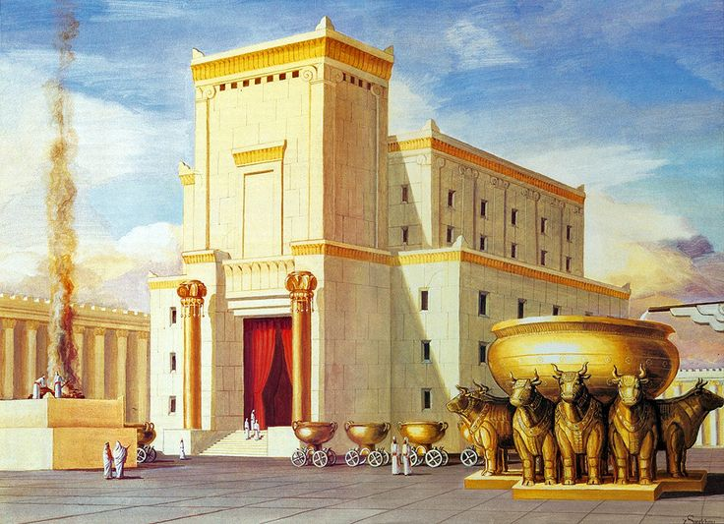

Slide 4
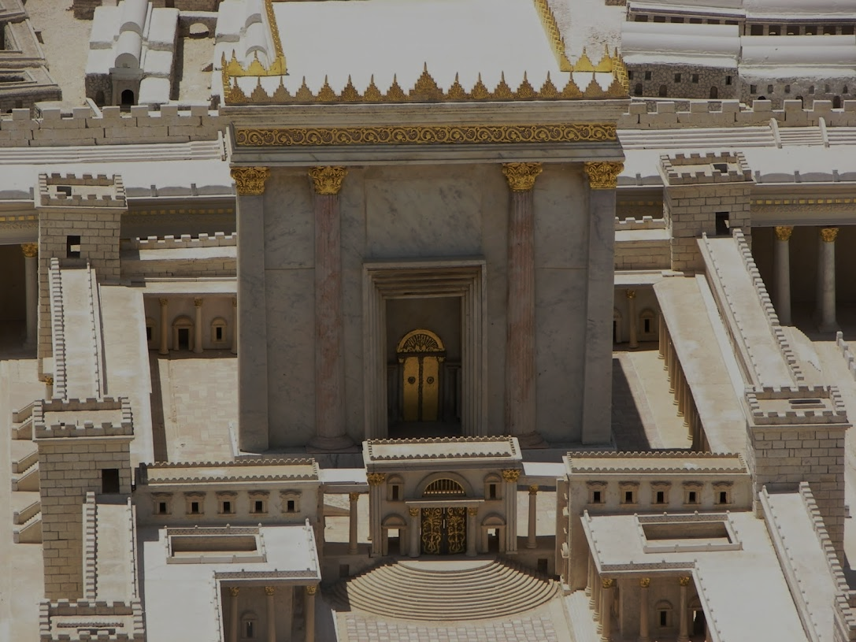
Fruitless religion
Mark 11:15-18
Cleanses the temple
Showed God’s judgement on what they offered as “religion”
It was fruitless Isaiah 5:1-7
It was irreverent v.16
It was selfish v.17
Notes:
v.16 – “Jesus did not want people to continue the practice of using the court as a shortcut through which to carry utensils and containers with merchandise to other parts of Jerusalem because such a practice revealed great irreverence for the temple—and ultimately for God Himself.” – John McAuther

Slide 5
For I delight in loyalty rather than sacrifice, and in the knowledge of God rather than burnt offerings.
Hosea 6:6

Slide 6
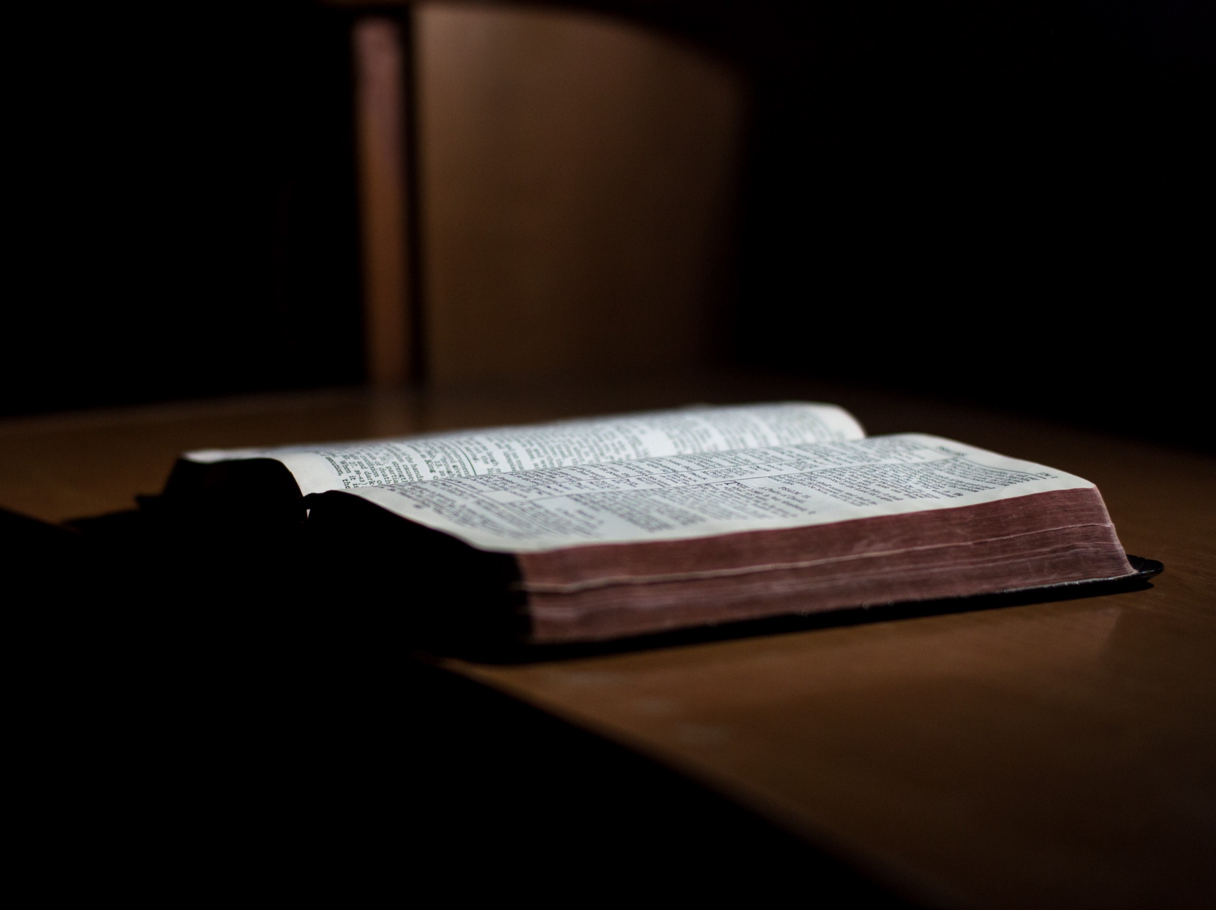
The fig tree and me:
Mark 11:19-21
I can be a fruitless, good-looking, fig tree
Luke 13:6-9
John 15:8-10
Notes:
Look good – [High school band disaster at contest, “At least you looked good.”]
Luke 13:6-9 – I am given the appropriate time to grow by God (fig tree did not produce fruit until the third year). However, there is a point in time when I am expected to have fruit!

Slide 7
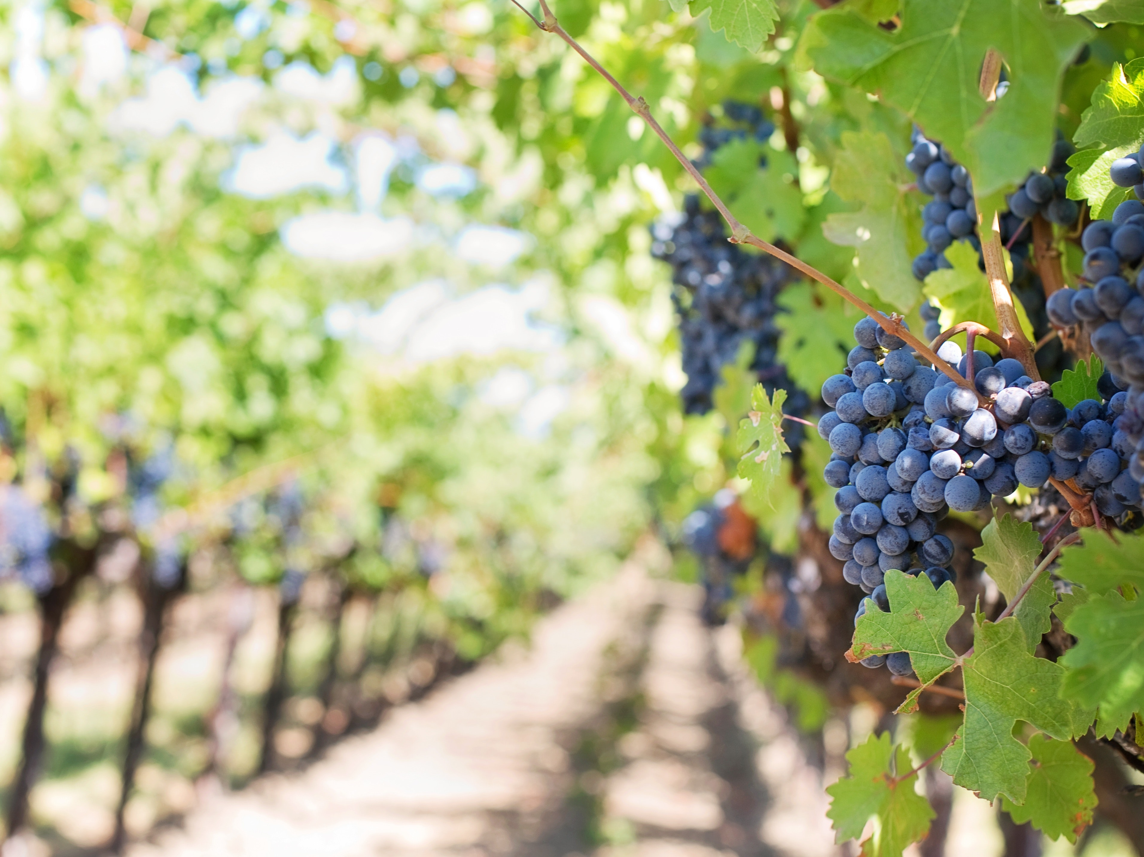
Therefore bear fruit in keeping with repentance
Notes:
Matthew 3:8-10

