Slide 1
Let’s Pretend
Ecclesiastes 1:1-11

Slide 2
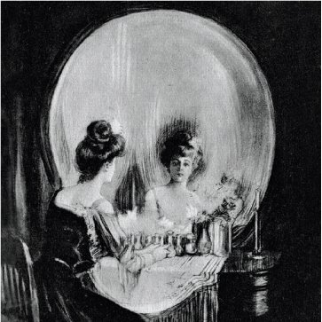

Slide 3
What Does it Profit? vv.1-3
All is vanity:
Hevel – Smoke or vapor. (Ps.34:5-6, 11)
Life is illusive, paradoxical, and cannot be tamed.
What gain is there? v.3
What does a person hope to get out of life?
Luke 12:16-20; Mark 8:36
Nothing!
Notes:
There is a “human desire to show a profit, to be in the black, whether financially or otherwise” (Gibson 23).

Slide 4
Life is Repetitive vv.4-8
The world around us either goes around and around or it comes and goes generation after generation.
Creation is hard at work doing the things it has always done.
But there is no end to it v.8
There is always the next ______.
Genesis 11:6 – No end to man’s ambitions.
Psalm 8:3 – No end to the expanse of the universe.
Notes:
But this is a blessing. When we embrace that life is full of patterns that we cannot change, again, it helps us to be truly appreciative of each season of our lives and to enjoy the little surprises that do pop up from time to time.

Slide 5
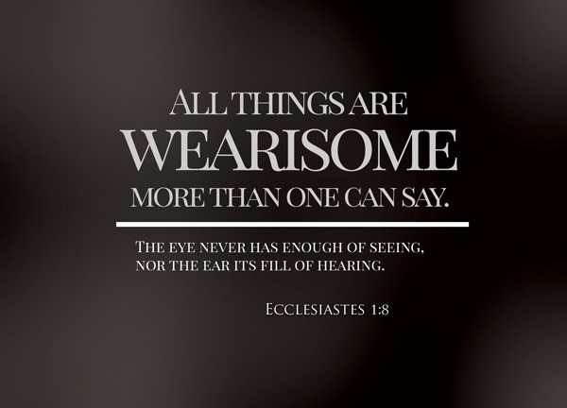

Slide 6
Nothing New Under the Sun vv.9-11
The more things change the more they stay the same: v.9
Sin is still sin, even with “new” names.
A government is still a government.
Toys are still toys.
Humans long for something more and so we spend our lives looking for it. v.10
We do so with no regard for history or even for what the it is v.11

Slide 7
Memento mori:
Remember death:
“At the outset, 1:1-11 sketches a very basic point: accepting death is the first step in learning how to live.” (Gibson 29)
Solomon is not simply saying there’s no gain in “striving after the wind” he’s also saying that there’s no need to strive in the first place.
The rest of Ecclesiastes will be a mediation on what is and what is not worth our striving.

