Slide 1
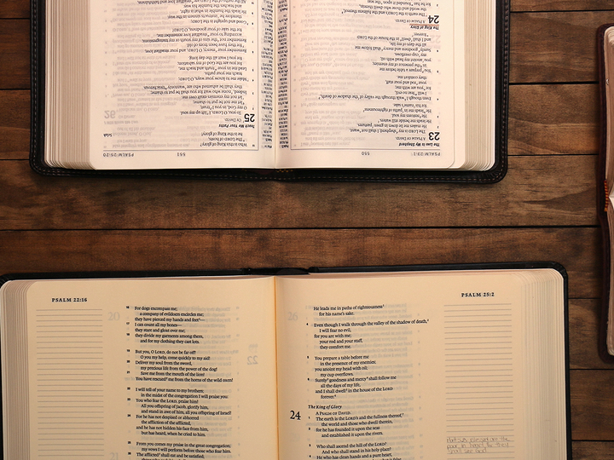
What is The Bible?
Churchofchristtucson.org

Slide 2
What is the Bible?
The Book of Books:
The Bible (Gk. Biblios) means simply book.
Because of the importance of its contents it is The Book of books. Nehemiah 8:1-3, 5-6
The Bible is a compilation of several different ‘books.’ Luke 24:27, 44
The Bible is the most influential book of all time! Acts 17:6

Slide 3
What is the Bible?
Two Major Divisions: Hebrews 1:1
Old Testament
39 Books, 32 Men.
Written from about 1500 BC to 400 BC.
Tells of the origin of man and God’s first covenants with mankind.
New Testament
27 Books, around 8 Men.
Written from 52 AD to 97 AD
Tells of the life of Christ, the spread of Christianity, and the letters to the first Christians.

Slide 4
Patriarchal
Mosaic
Christian
Adam
Moses
Christ
The Kingdom
The Church
Col. 1:13
Acts 2:47
RED
SEA
FLOOD
1654
857
Eden
120
Tents
400
40
355
120
388
33
2511 yrs.
Current
1481 yrs.
God Spoke to the Fathers
Heb. 1:1
Animal Sacrifice
Family Alter
Law Came by Moses
John 1:17
Animal Sacrifice
Temple Worship
Grace and Truth
John 1:17
Came by Christ

Slide 5
What is the Bible?
Three Major Time Periods:
Time of the fathers (Patriarchal)
Time of Moses (The Law)
Fulfilled Matthew 5:17
Done away with Colossians 2:14-18; Galatians 3:23-24
Time of Christ (The Gospel)
We live under this law.
Hebrews 1:1-2

Slide 6
What is the Bible?
Inspired and Profitable:
2 Timothy 3:16
Inspired = God breathed.
The message wasn’t left up to chance or interpretation. 2 Peter 1:20-21
It is profitable:
As a guide for life. Psalm 119:105
As a means for transformation. Romans 12:2
For salvation. James 1:21

