Slide 1
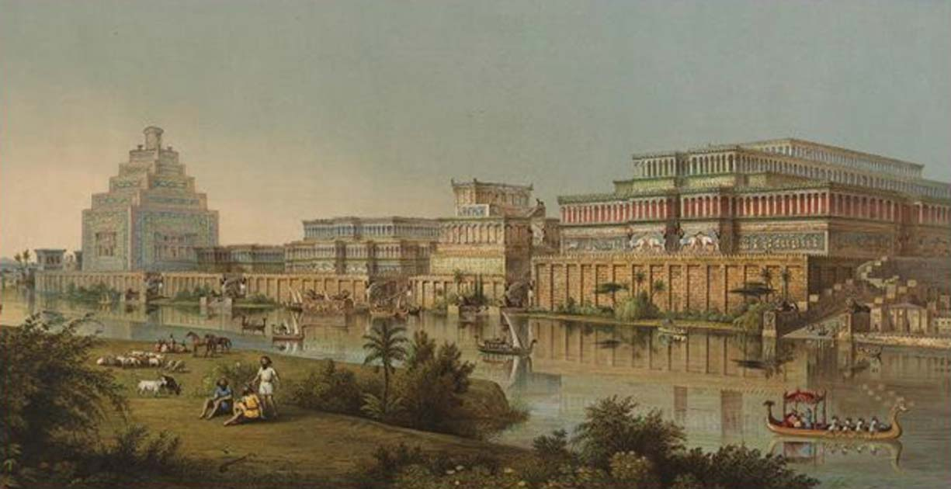
NINEVEH: 100 YEARS LATER
CHURCHOFCHRISTTUCSON.ORG

Slide 2
NAHUM:
Let’s Go Back to Jonah:
Jonah 1:1-2 – Jonah sent to preach to Nineveh for them to repent.
Jonah runs Jonah 1:3- chapter 3
Nineveh repents Jonah 3:5-6
Happy ending, right?

Slide 3
NAHUM:
Nahum 1: The Lord is Good
122 Years Later:
Nahum 3:19b – Repentance did not last.
Vengeance is the Lord’s vv.1-2
God is just (v.3) and because of His justice the unrighteous will be held accountable.
Who can stand before God’s wrath. vv.4-8

Slide 4
NAHUM:
Nahum 1: The Lord is Good
Nineveh will be destroyed. v.14
This is good news to Judah. v.15
Do I want to be Nineveh later in my life? Matthew 3:7-9

Slide 5
NAHUM:
Nahum 2: The Lord is Against You
The Lord is against you vv.1-7
Nineveh will plead for mercy but find none. vv.8-12
God is against you and He will make war with you. v.13
Will we be numbered among God’s enemies? Revelation 2:12ff

Slide 6
NAHUM:
Nahum 3: The Lord is Just
Nineveh’s destruction is coming on them for their evil which knows no limit. v.19b

Slide 7
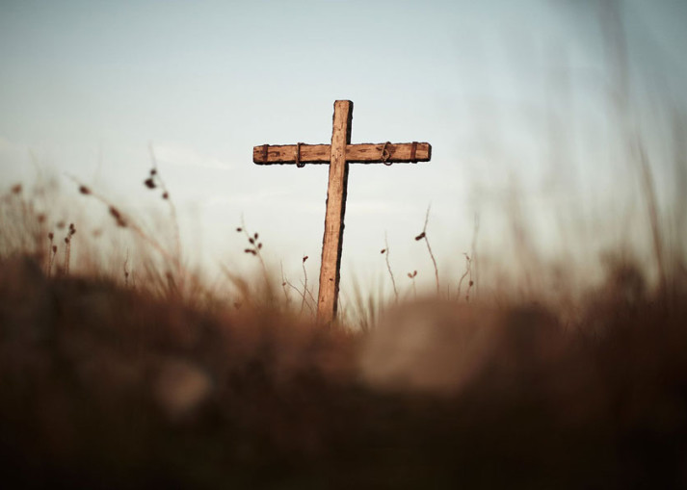

Slide 8
Romans 1:16
Romans 3:21-26

