Slide 1
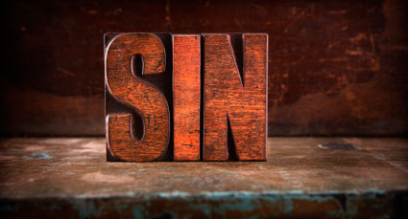
Straight Talk About Sin
Churchofchristtucson.org

Slide 2
Straight Talk About Sin
It has power:
It allures Gen. 3:6; 1 John 2:16
It is deceptive Gen. 3:1-5; Heb. 11:24-25
It enslaves John 8:34

Slide 3
Straight Talk About Sin
It Stains:
Our reputation Ecclesiastes 10:1
Our bodies Romans 1:26-27
Our souls Jeremiah 2:19-23

Slide 4
Straight Talk About Sin
Its Consequence:
We all suffer the consequence of sin. Romans 3:23, 10-12
We are separated from God Isaiah 59:1-2
Sin cost the precious blood of Christ to remove its debt. Romans 5:6-9

