Slide 1
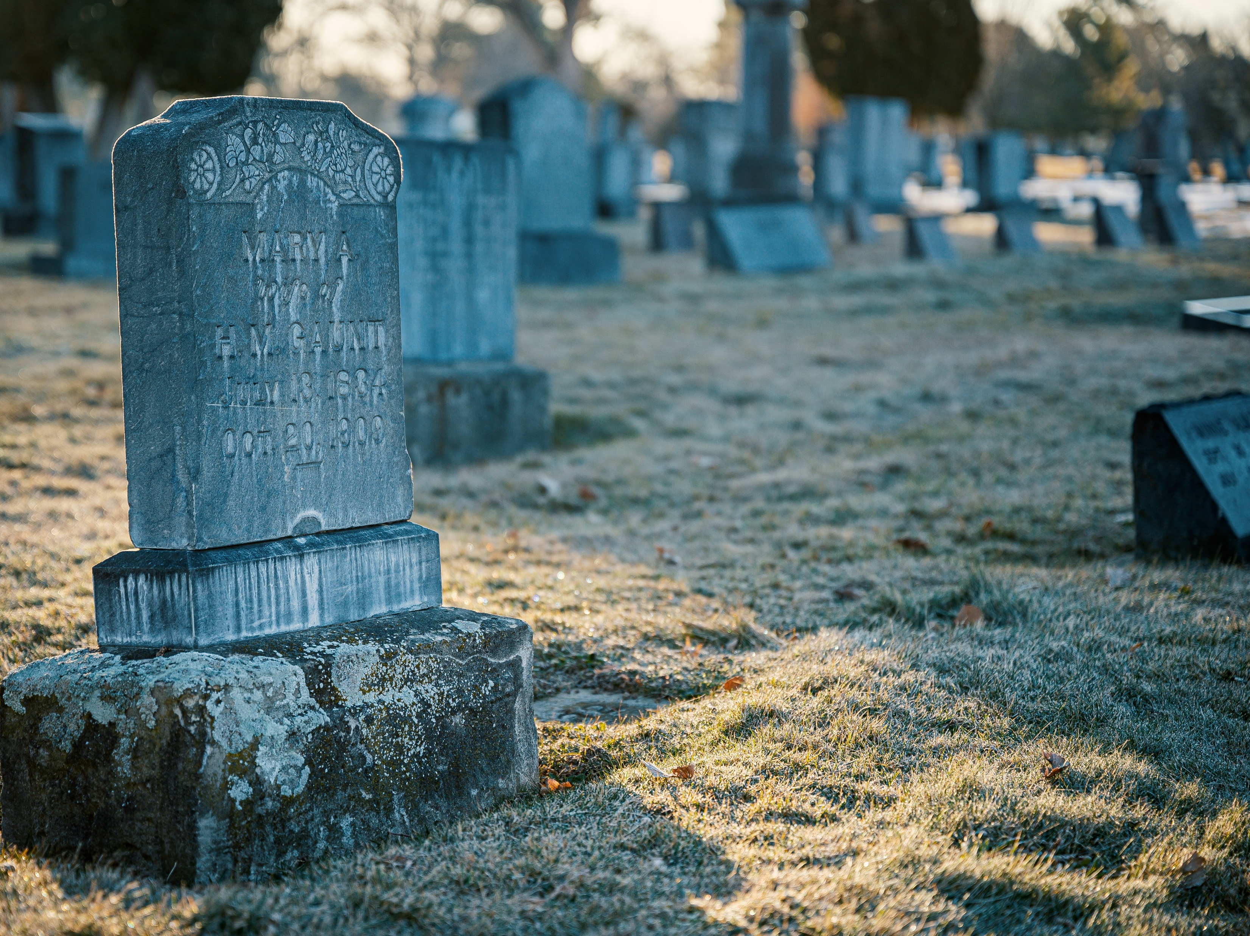
The Death of Jesus
Churchofchristtucson.org

Slide 2
The death of Jesus
Took away God’s Wrath. 1 John2:2
Removed the Power of Death. Ezek. 18:20; Heb. 2:5-9
Demonstrated God’s Love. Rom. 5:6-11; 1 John 4:10
Made Possible Resurrection. Rom. 1:4; 1 Peter 3:18-22; Rom. 6:1-10
Can Save Your Soul. 1 Cor, 15:12-17

