Slide 1
Devoted to prayer
churchofchristtucson,.org

Slide 2
How is your prayer life?

Slide 4
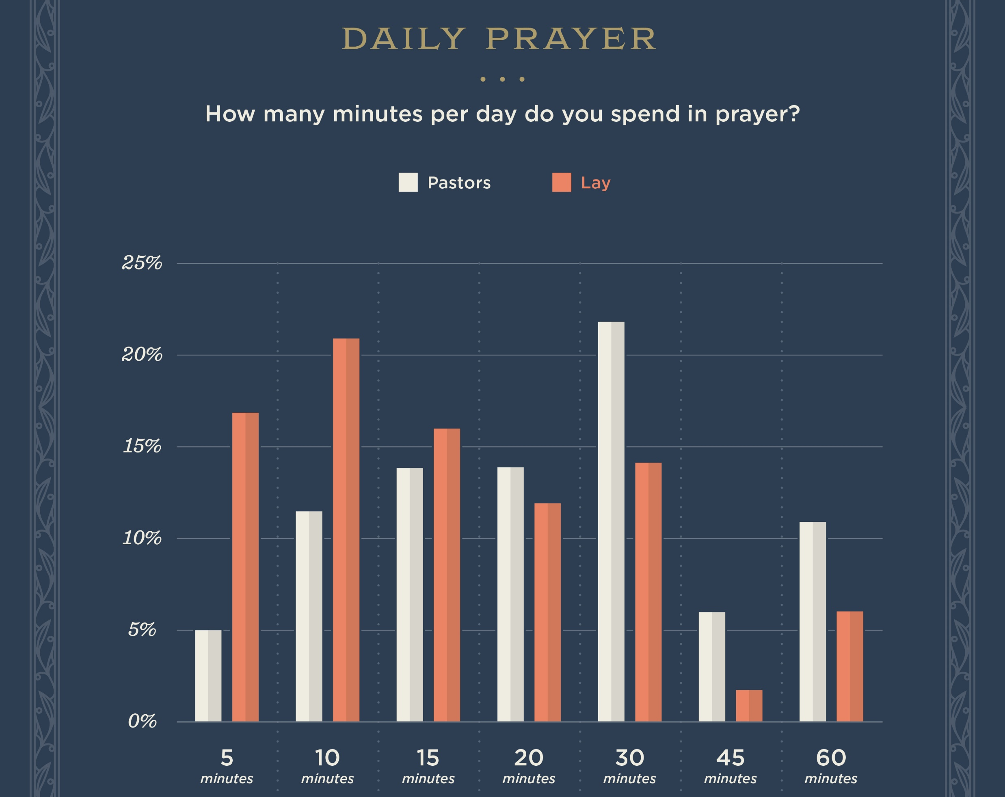

Slide 7
What is keeping us from prayer?

Slide 9
Devoted to prayer: Romans 12:12
What is keeping us from prayer?
We are a distracted people.
Proverbs 4:25; 5:1; 1Peter 5:8
What can I do about it? Proverbs 23:7a; Romans 12:12

Slide 10
Devoted to prayer: Romans 12:12
How Can I Improve My Prayer Life?
Have scheduled periods of prayer. Daniel 6:10
Start small. 1 Thessalonians 5:17
Have aids to prayer. Matthew 6:7
Let scripture inform your prayers. Ephesians 3:14-21

