Slide 2
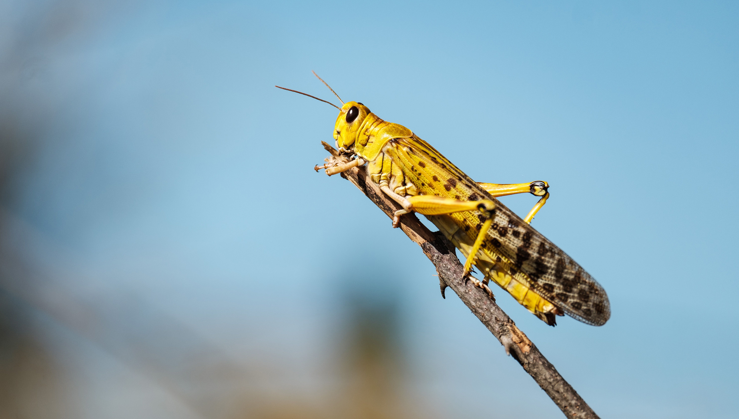
The Locusts Have Come
Churchofchristtucson.org

Slide 3
Joel 1: The Locusts Have Come
The Prophet, His Times, and His Message:
Post-exile prophet – probably. (Joel 3:2, 5, 6).
“the word of the Lord that came to Joel the son of Pethuel” (Joel 1:1).
The message:
Judgement is coming (Joel 1:15; 2:1, 11, 31; 3:14).
Therefore repent (Joel 2:12-14).
This can bring hope (Joel 2:25-27) or fear (Joel 2:11).

Slide 4
Joel 1: The Locusts Have Come
The land is laid waste. (Joel 1:2-4; Deut. 28:38)
A nation called to mourn. (Joel 1:5-14; Isa. 37:22; Lam. 2:13)
The day of the Lord is at hand. (Joel 1:15-20)

Slide 5
Joel 1: The Locusts Have Come
What do we make of this?
God is faithful to Himself.
If the land and animals cry out to God, shall we not do so more?
There is a day of the Lord coming. Are you ready for it?

