Slide 1
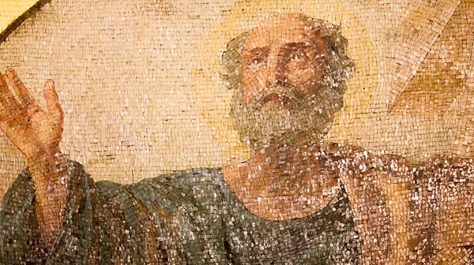
Acts 15 and Bible Authority
Churchofchristtucson.org

Slide 2
Acts 15 and Bible Authority:
Context and the Issue (Acts 15:1-5).
Peter’s Testimony (Acts 15:6-11).
Paul and Barnabas’ Testimony (Acts 15:12).
James’ Testimony (Acts 15:13-21).

