Slide 2
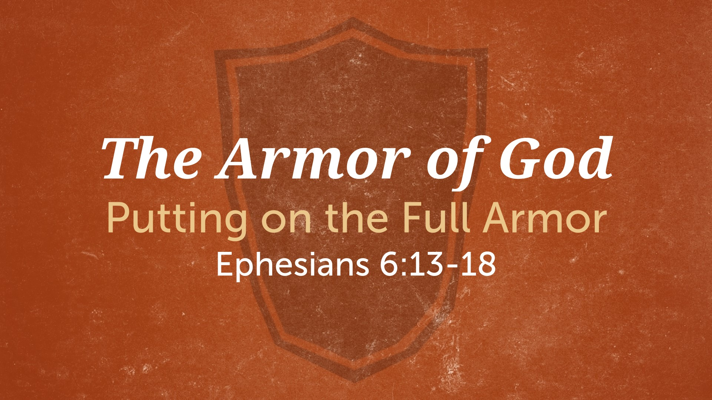

Slide 3
Putting On The Full Armor:
Eph. 6:13-18
Take Up The Full Armor of God.
  The belt of truth. Eph. 6:14; 2 Tim. 2:15; Jas. 1:22
  The breastplate of righteousness. Eph. 6:14; 1:7-8; 4:1
  The boots of the Gospel. Eph. 6:15

Slide 4
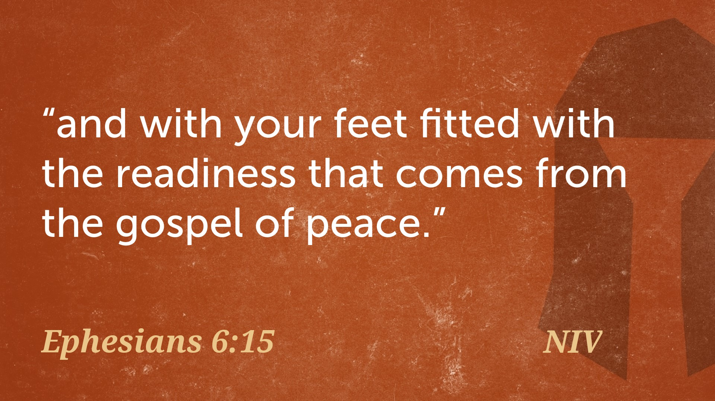

Slide 5
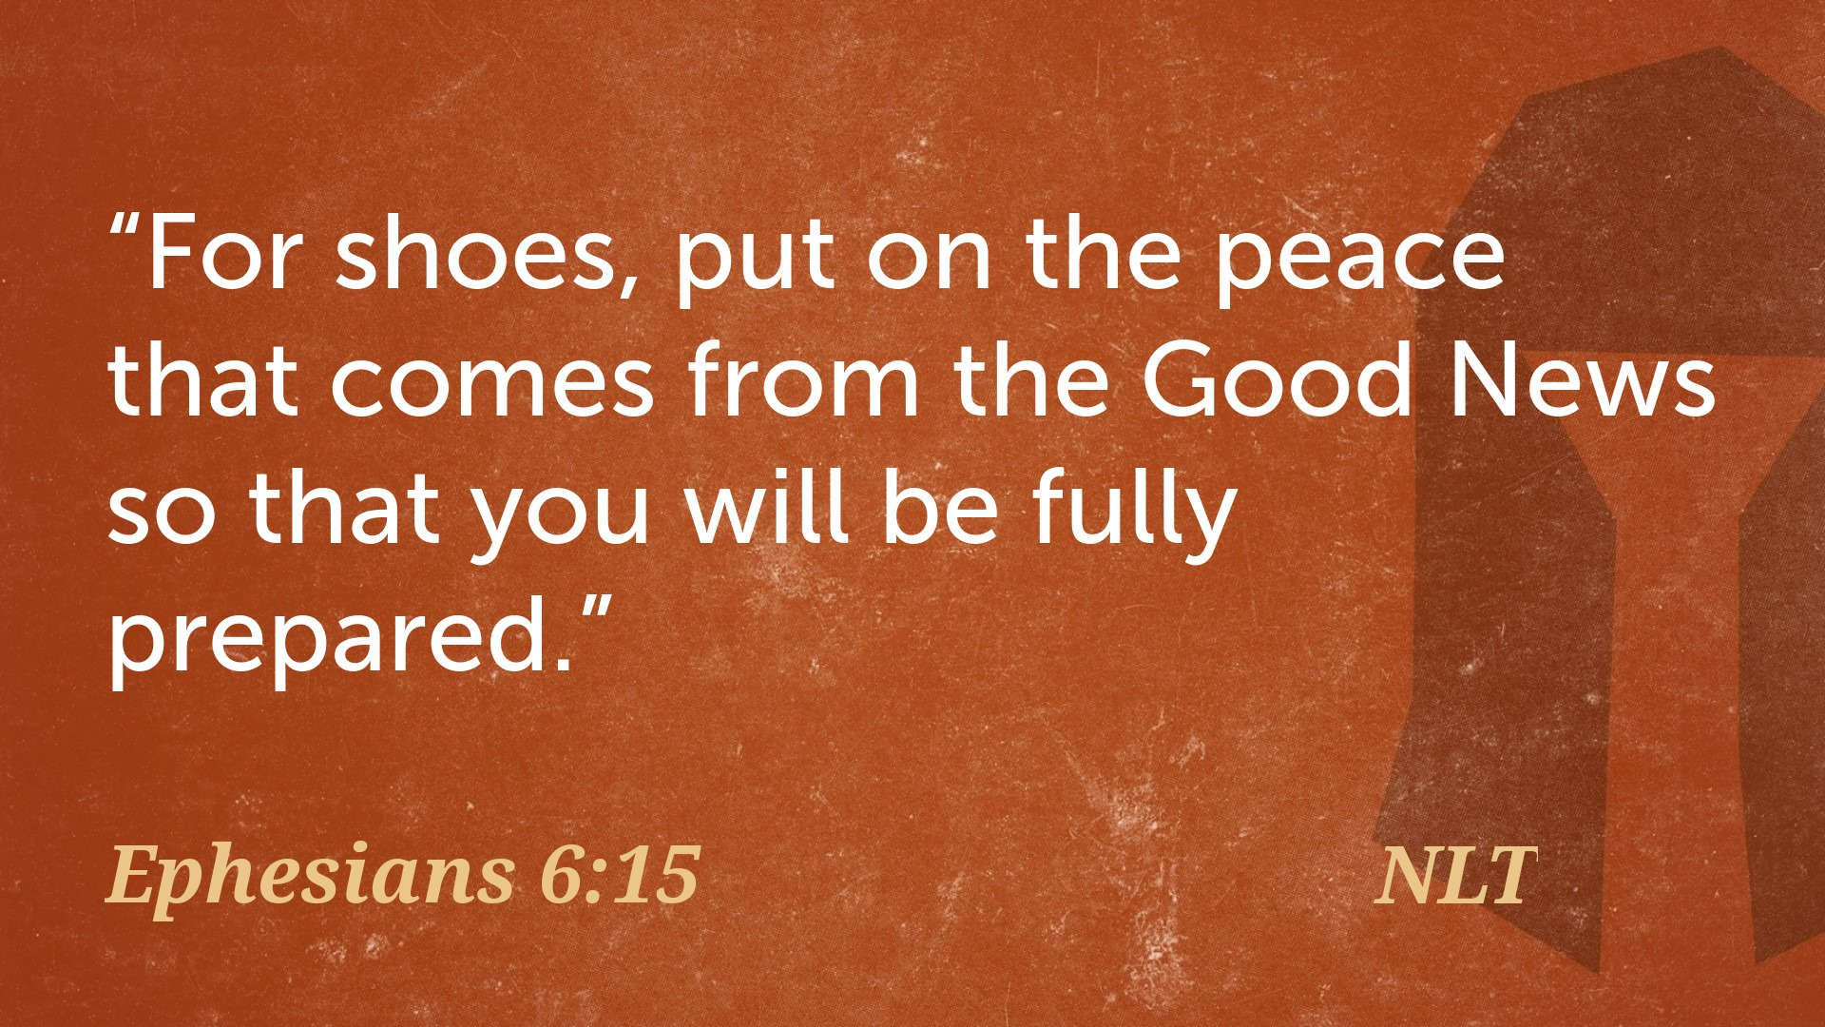

Slide 6
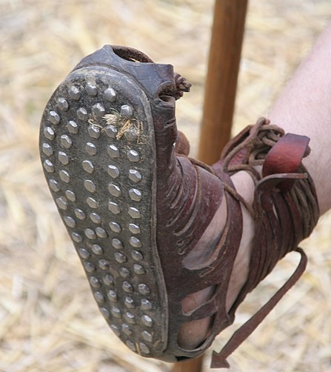
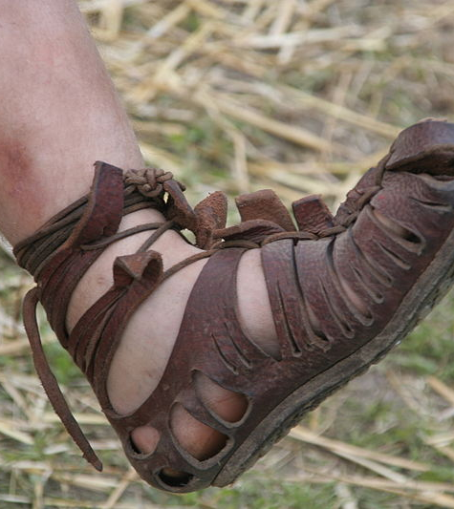

Slide 7
Putting On The Full Armor:
Eph. 6:13-18
Take Up The Full Armor of God.
  The belt of truth. Eph. 6:14; 2 Tim. 2:15; Jas. 1:22
  The breastplate of righteousness. Eph. 6:14; 1:7-8; 4:1; 1 Jn. 3:18
  The boots of the Gospel. Eph. 6:15; Rom. 6:17-18; 1 Cor. 6:9-11
  The shield of faith. Eph. 6:16; Ps. 18:30; Rom. 10:17

Slide 8
Putting On The Full Armor:
Eph. 6:13-18
Take Up The Full Armor of God.
  The helmet of salvation. Eph. 6:17; Phil. 1:6; Rom. 8:35-39
  The sword of the Spirit. Eph. 6:17; Heb. 4:12
Putting The Armor On With Prayer.
  Eph. 6:18
  Pray through Eph. 6:13-17.

Slide 9
What must I do to be saved? Acts 16:30
Believe in Jesus; John 8:24
  Repent of Sins; Luke 13:3
    Confess our Faith in Christ; Matt. 10:32-33
      Be Baptized for the Remission Of Sins; Mark 16:16; Acts 2:38

