Slide 1
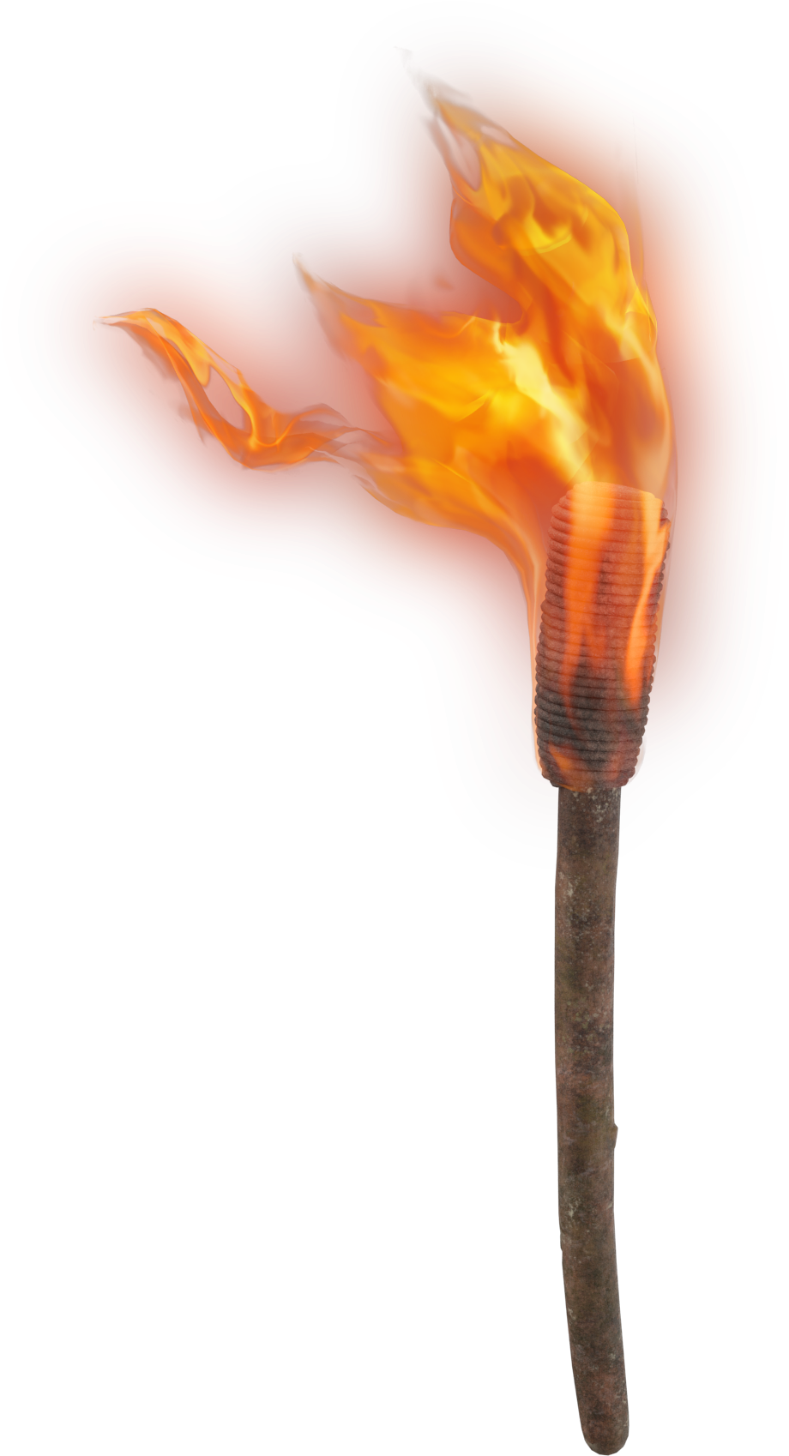
LIGHT THE F RE
Were not our hearts burning within us while He was speaking to us ..., while He was explaining the Scriptures to us?
Luke 24:32

Slide 2
Yearning, Burning
Luke 24:13-35

Slide 3
My God, my God, why have You forsaken me?
Far from my deliverance are the words of my groaning.
O my God, I cry by day, but You do not answer;
and by night, but I have no rest.
—Psa 22:1-2
Luke 24:13-21
Solemn Reflections

Slide 4
Why are you in despair, O my soul?
And why have you become disturbed within me?
Hope in God, for I shall yet praise Him,
The help of my countenance and my God.
—Psa 42:11
Luke 24:13-21
Solemn Reflections

Slide 5
The unfolding of Your words gives light;
It gives understanding to the simple.
—Psa 119:130
Luke 24:25-27
Stunning Realizations

Slide 6
Jesus secured the victory…
…over sin
—1 John 3:9
…over Satan
—1 John 3:8
…over death
—Heb 2:14-15
Luke 24:28-35
Spiritual repurcussions

Slide 7
Yearning, Burning
Luke 24:13-35

