Slide 1
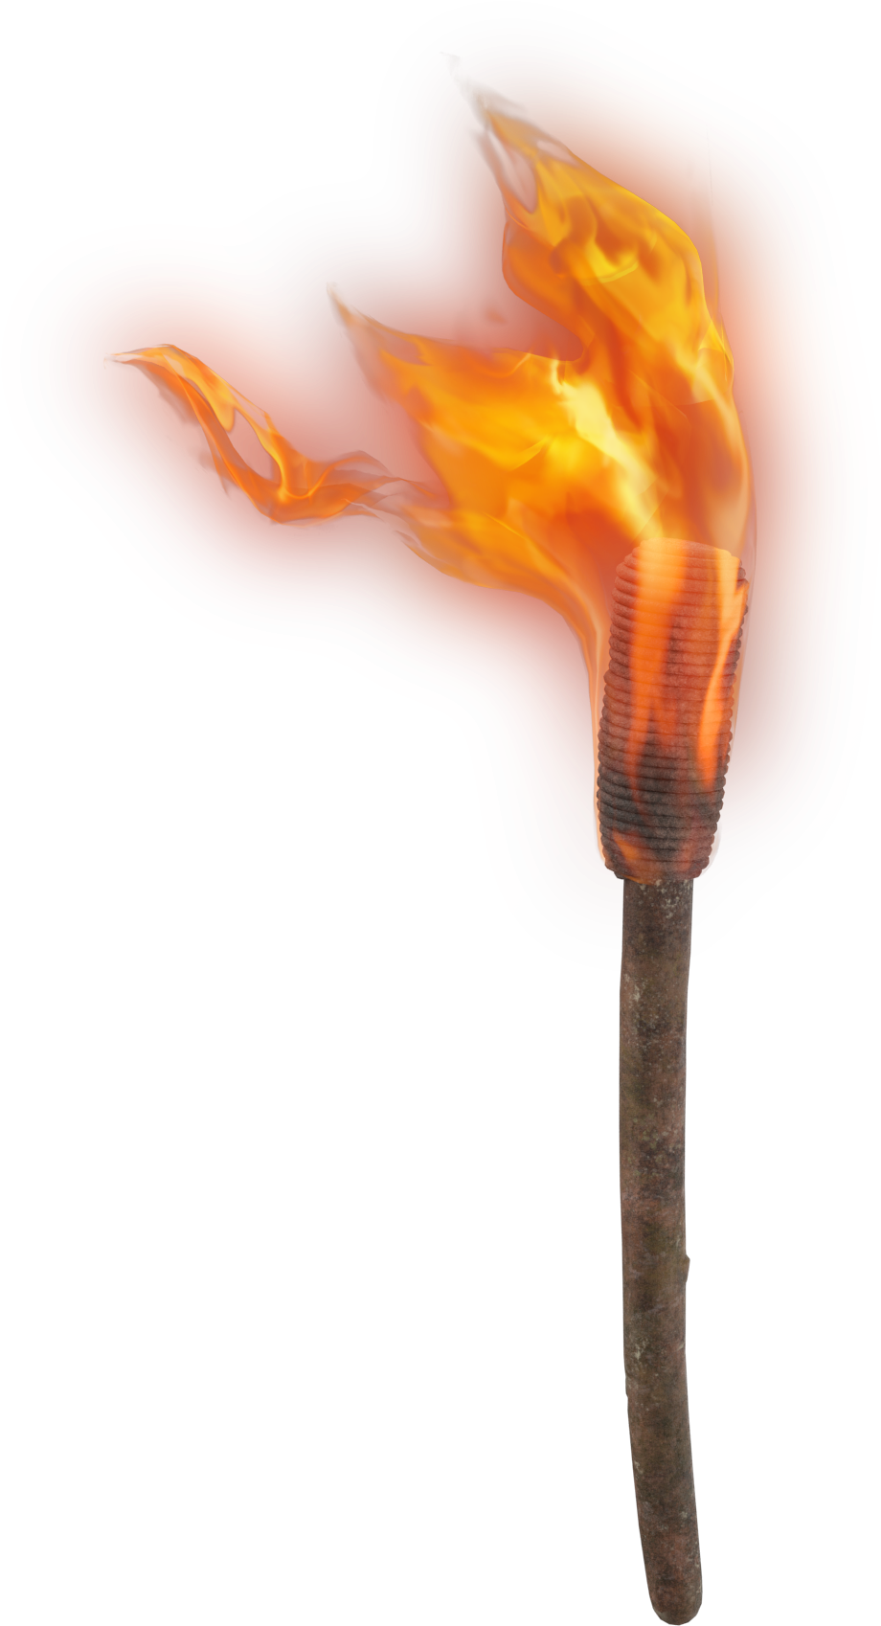
LIGHT THE F RE
Were not our hearts burning within us while He was speaking to us ..., while He was explaining the Scriptures to us?
Luke 24:32

Slide 2
REVIVAL IN
RESURRECTION
1 Corinthians 15:50-57

Slide 3
Jesus’ Revival:
Mark 16:1-8
His prophecy fulfilled
―John 2:18-21
His power displayed
―John 10:17-18
His deity declared
―Rom 1:4
REVIVAL IN
RESURRECTION

Slide 4
The Apostles’ Revival:
John 20:19-29
Confident
―Acts 2:14-32
Courageous
―Acts 4:7-12
We must obey God rather than men!
REVIVAL IN
―Acts 5:29
RESURRECTION

Slide 5
YOUR Revival:
Romans 6:3-11
Freedom!
―Rom 6:12-14
Hope!
―1 Cor 15:18-20
Resurrection!
―1 Cor 15:50-57
Therefore, my beloved brethren, be steadfast, immovable, always abounding in the work of the Lord, knowing your toil is not in vain in the Lord.
REVIVAL IN
RESURRECTION
―1 Cor 15:58

