Slide 1
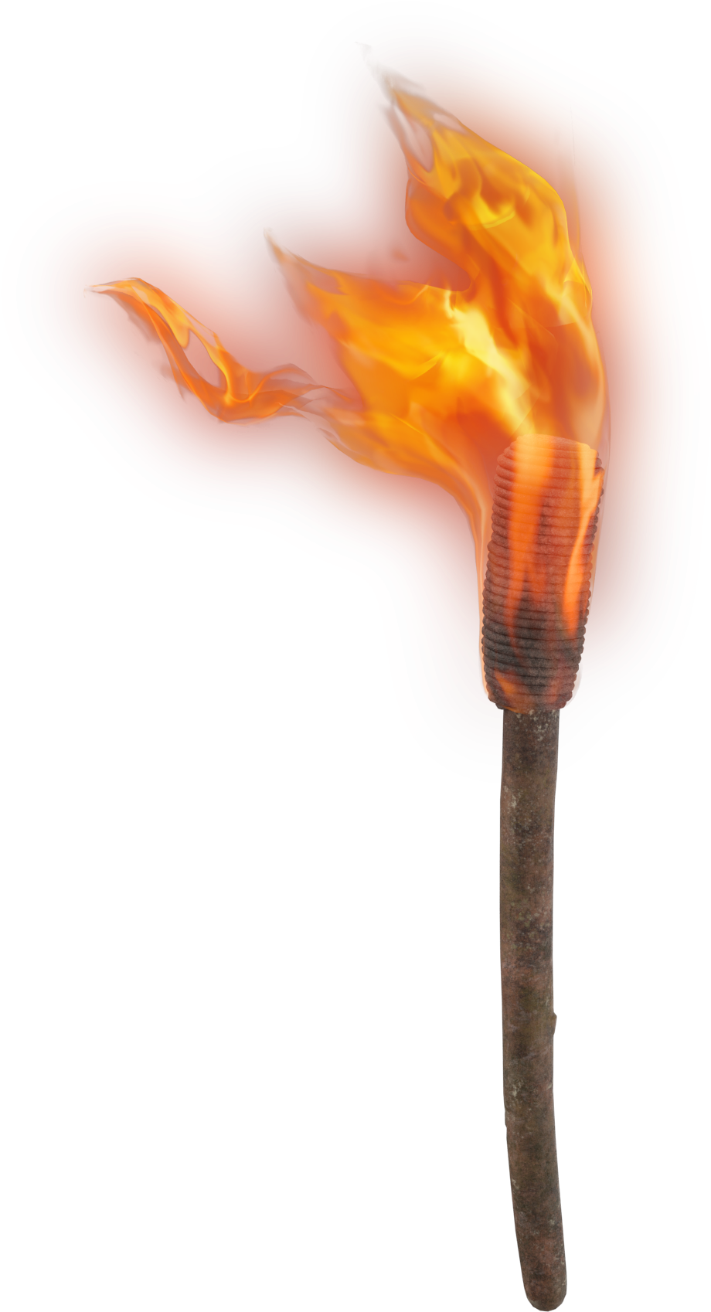
LIGHT THE F RE
Were not our hearts burning within us while He was speaking to us ..., while He was explaining the Scriptures to us?
Luke 24:32

Slide 2
FAN THE
FL ME
But Mind The Fire

Slide 3
His disciples remembered that it was written, “Zeal for your house will consume me.” ―John 2:17
But when the Jews saw the crowds, they were filled with jealousy and began contradicting the things spoken by Paul, and were blaspheming.
―Acts 13:45

Slide 4
Fired Up… for the wrong things
Phil 3:4-6; Gal 1:13-14
Paul’s example:
"Those people are zealous to win you over, but for no good. What they want is to alienate you from us, so that you may be zealous for them." ―Gal 4:17

Slide 5
Uncontrolled Burn
Excitement without Education
Paul’s lament:
Rom 10:1-4
Therefore be careful how you walk, not as unwise men but as wise, making the most of your time, because the days are evil. So then do not be foolish, but understand what the will of the Lord is.
―Eph 5:15-17

Slide 6
Uncontrolled Burn
Excitement without Education
So then do not be foolish, but understand what the will of the Lord is.
Command
Observe
Approved Example
Interpret
Necessary Inference
Apply

Slide 7
Uncontrolled Burn
Excitement without Education
Better is a poor man who walks in his integrity
Than he who is perverse in speech and is a fool.
Also it is not good for a person to be without knowledge,
And he who hurries his footsteps errs. ―Prov 19:1-2

Slide 8
Fanning the Flame;
Minding The Fire
To receive the Word:
Acts 17:11
To promote repentance:
2 Cor 7:8-12
To grow in grace:
2 Pet 1:5-11
To please God:
Col 3:23

Slide 9
FAN THE
FL ME
But Mind The Fire

