Slide 1
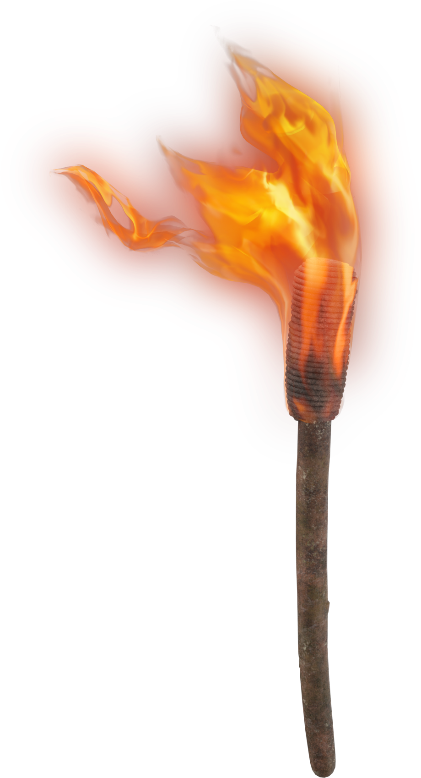
LIGHT THE F RE
Were not our hearts burning within us while He was speaking to us ..., while He was explaining the Scriptures to us?
Luke 24:32

Slide 2
the call of
COMMITMENT

Slide 3
the call of
COMMITMENT
Nehemiah’s prayer 1:1-11
Promise: vs 5
Confession: vv 6-7
Confidence: vv8-10
Plea: vs 11
The result: 6:15-16

Slide 4
the call of
COMMITMENT
Clear Perspective-2:11-16
Where there is no revelation, the people cast off restraint; But happy is he who keeps the law.
―Prov 29:18

Slide 5
the call of
COMMITMENT
Compelling Purpose-2:17-20
Let us consider how to stimulate one another to love and good deeds.
―Heb 10:24

Slide 6
the call of
COMMITMENT
Continual Prayer - 4:4-5

Slide 7
Continual Prayer - 4:4-5
But we prayed to our God -4:9
Remember me, O my God, for good, according to all that I have done for this people. -5:19
But now, O God, strengthen my hands. -6:9
Remember, O my God... -6:14

Slide 8
Continual Prayer - 4:4-5
Remember me for this, O my God… -13:14
For this also remember me, O my God, and have compassion on me… -13:22
Remember them, O my God… -13:29
Remember me, O my God, for good. -13:31

Slide 9
the call of
COMMITMENT
Continual Prayer - 4:4-5
“Truly, truly, I say to you, he who believes in Me, the works that I do, he will do also; and greater works than these he will do; because I go to the Father. Whatever you ask in My name, that will I do, so that the Father may be glorified in the Son. If you ask Me anything in My name, I will do it.”
―John 14:12-14

Slide 10
the call of
COMMITMENT
Courageous Persistence -4:1-6, 11-14
“Do not be afraid of them; remember the Lord who is great and awesome, and fight for your brothers, your sons, your daughters, your wives and your houses.”
―Neh 4:14

Slide 11
ANSWER the call of
COMMITMENT
A Clear Perspective
A Compelling Purpose
A Continual Prayer
A Courageous Persistence

Slide 12
the call of
COMMITMENT

