Slide 1
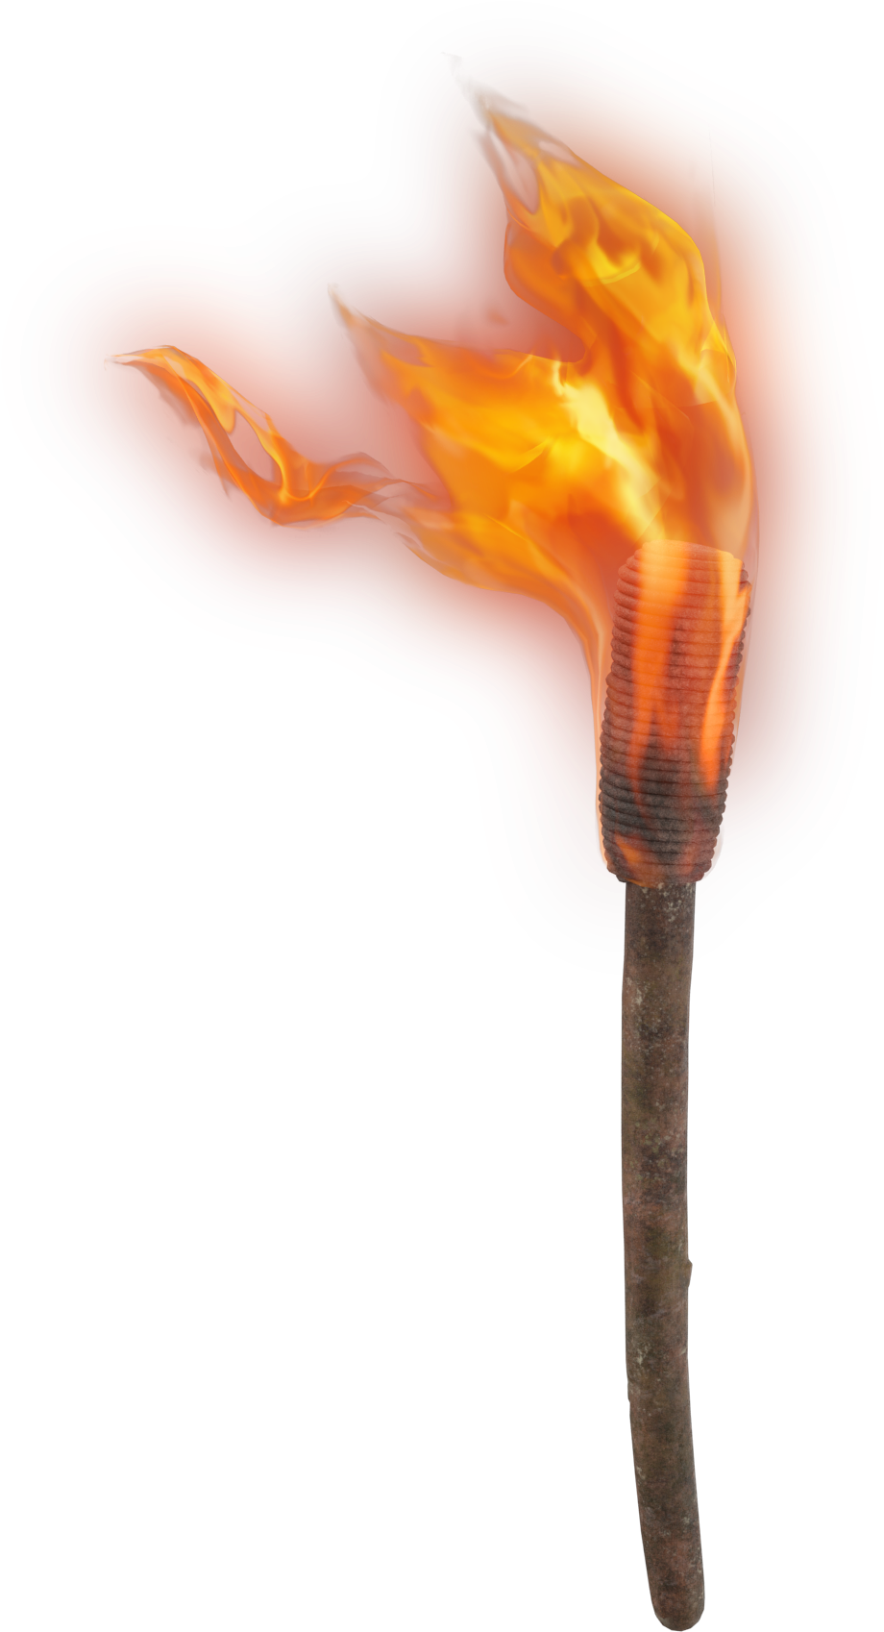
LIGHT THE F RE
Were not our hearts burning within us while He was speaking to us ..., while He was explaining the Scriptures to us?
Luke 24:32

Slide 2
RE
NDLING
K
MY PASSION
2 Timothy 1:5-6

Slide 3
VALUE THE GOSPEL
RE
K
INDLE
It is unimaginably important
1 Thess 2:13
It is anchored in eternity
2 Cor 5:4

Slide 4
SUFFER FOR THE GOSPEL
RE
K
INDLE
For to you it has been granted for Christ’s sake, not only to believe in Him, but also to suffer for His sake
Phil 1:29

Slide 5
GUARD THE GOSPEL
RE
K
INDLE
Be diligent to present yourself approved to God as a workman who does not need to be ashamed, accurately handling the word of truth.
2 Tim 2:15
COMMAND
EXAMPLE
NECESSARY INFERENCE

Slide 6
FURTHER THE GOSPEL
RE
K
INDLE
...and they were all scattered throughout the regions of Judea and Samaria...Therefore, those who had been scattered went about preaching the word.
Acts 8:1, 4

Slide 7
RE
NDLING
K
MY PASSION
2 Timothy 1:5-6

